Slide 1
Contextual Challenge 2020-2021
By Kahngjoon Koh

Slide 2
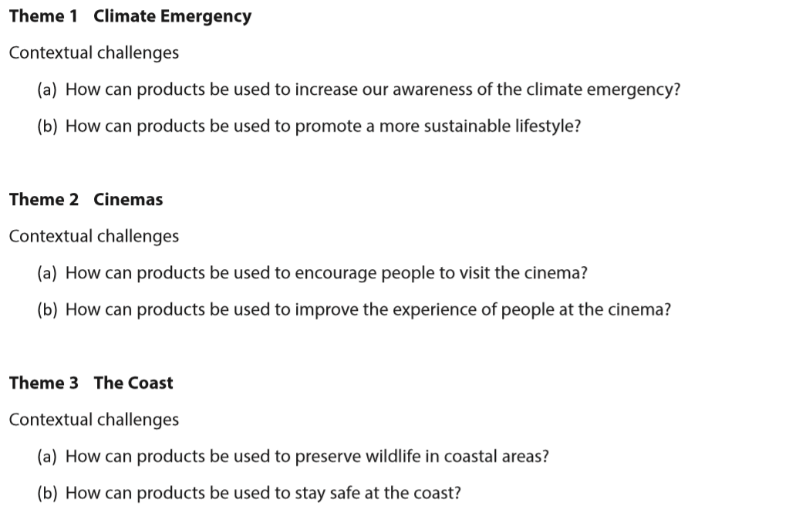
Choosing the Contextual Challenge

Slide 3
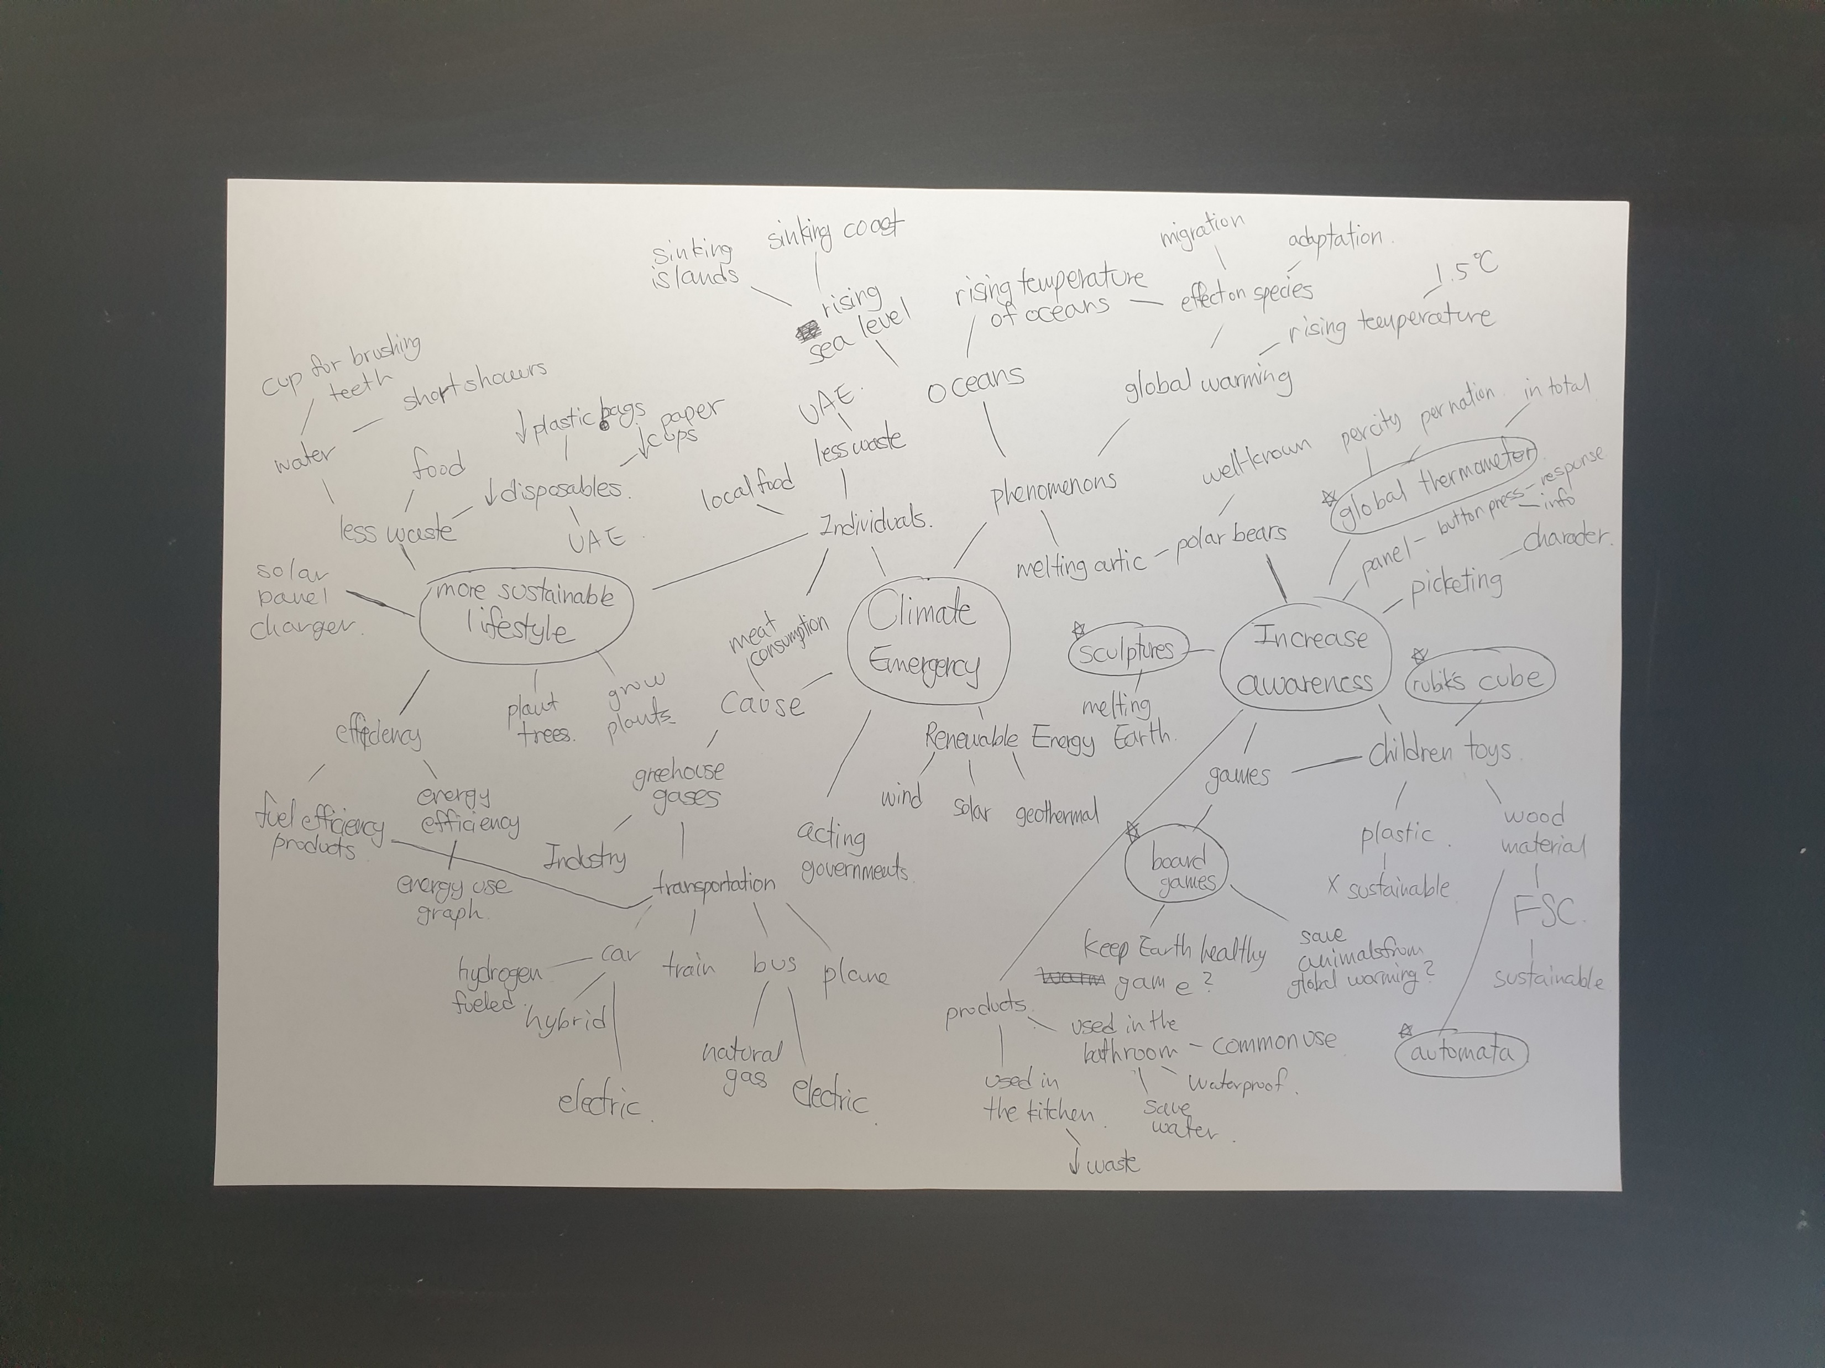
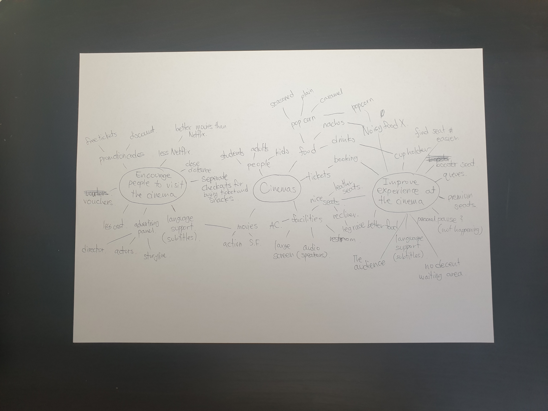
Choosing the Contextual Challenge
To choose the most suitable option I have considered every theme and question. Hence, I have created a mind map for each theme to portray my general knowledge and the possible ideas related to it. As a result, I could overview the choices and make the most reasonable decision.
Theme 1: Climate Emergency
This was the most familiar theme to me. I was able to produce the largest and informative mind map.
How can products be used to increase our awareness of the climate emergency?
This contextual challenge was interesting as the place I live in was the UAE. I have not lived here long but it was enough for me to realize the overuse of disposables and lack of regulations related to climate emergency. As I felt the need for increasing awareness myself, I found this a contextual challenge that I will be really engaged in.
How can products be used to promote a more sustainable lifestyle?
This also relates to my experience in where I live. I can spot many wasteful behaviours that needs change. For example, washing the cars every day and not recycling. I felt excited about the concept of changing the demographics’ behaviour, however, after brainstorming about it I could not think of an adequate solution except for educating them about the climate emergency which is basically the former contextual challenge.
Theme 2: The Cinema
Cinemas sounded very familiar, but when I started brainstorming about it, it turned out to be not.
How can products be used to encourage people to visit the cinema?
As I do not go to the cinema often, I questioned myself why would I not go to cinemas. I figured there was no actual need to go to the cinema except for watching hit-movies or just released movies. In fact, many movies are available to be watched in homes which are more convenient. What I thought was the most effective method in encouraging people to visit the cinema was to advertise the movie. And that quite limits my range of products. As a result, I did not choose this contextual challenge.
How can products be used to improve the experience of people at the cinema?
I made a brief research of what people though about the experiences at the cinema. The research told the problem was diverse. Starting from bringing crunchy food in the cinema, not turning their mobile devices off and talking noises that could be heard. The problems were mostly because of the audience’s behaviour and not much to do with the cinema itself. Therefore, I concluded this contextual challenge to be inadequate for me.

Slide 4
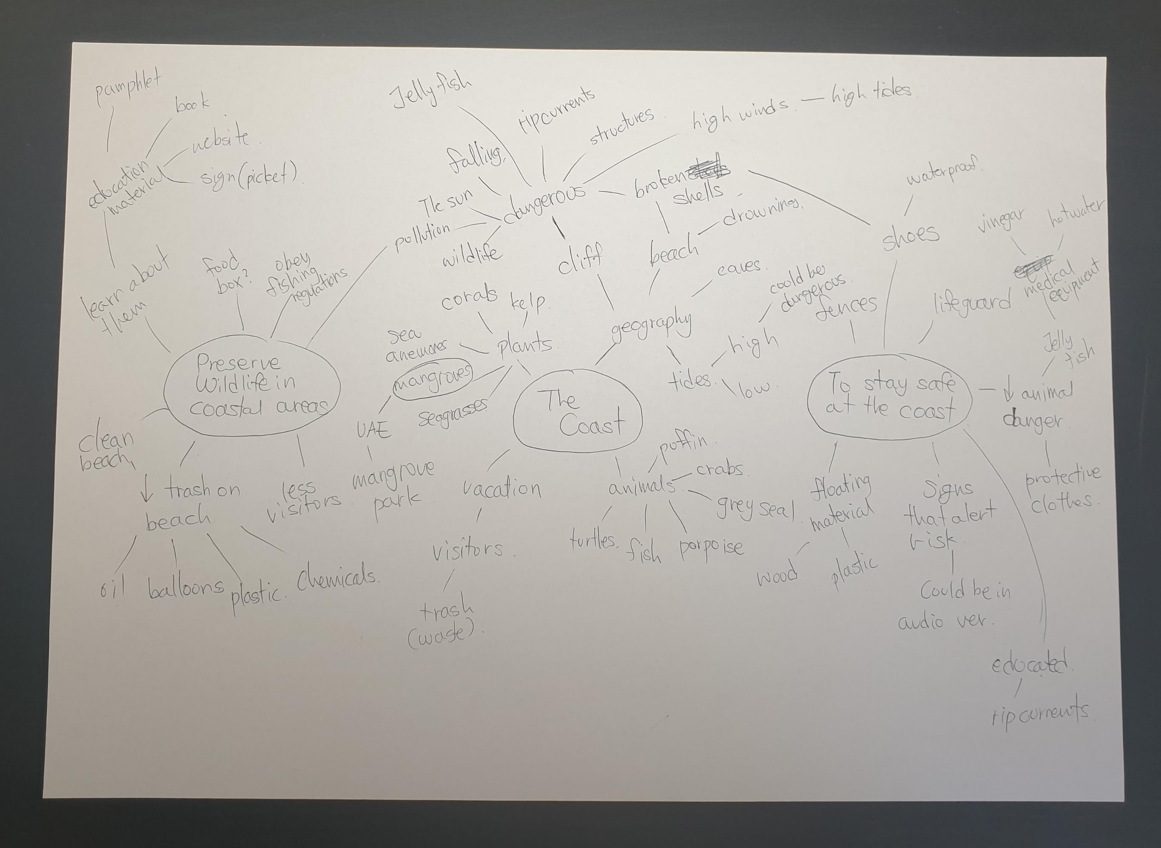
Choosing the Contextual Challenge
Theme 3: The Coast
The theme was a challenge as I was not familiar with the coast. Therefore, I had to research information to get a decent overview of the theme.
How can products be used to preserve wildlife in coastal areas?
It was fortunate to live in the UAE and have access to many coastal areas including The Mangrove, Corniche, and Al Bateen beach which is close by. This physical proximity would help me out in researching the wildlife and coming up with initial ideas.
How can products be used to stay safe at the coast?
I have been to Al Bateen Beach and personally the sand had many broken sea shells that may cause a cut. It was appealing as approach “staying safe at the coast” could be done both physically(fences) and mentally(putting up warning signs). One thing that was confusing about the challenge was that there could be two possible types of “coasts”. The first one would be the beach; the second would be the rocky cliff near the ocean. Each one has its own dangers which made me confusing. Furthermore, UAE does not have the latter. As a result, I have excluded the option.
My Choice:
How can products be used to increase our awareness of climate emergency?
I thought familiarity was important for the thinking up with initial ideas and adaptation of the products I will be making. Similarly, I valued my personal motivation. Furthermore, the UAE government is starting to consider climate emergency(have not yet declared climate emergency) which means I can benefit from it in someway.(more interest in my product, more people who heard of the term, better feedback that gives more possibility to improve, etc) Also, the broadness of the topic gives me more range of products that I can make. Therefore, I have chosen this contextual challenge.
Notes:
“I can benefit from it in someway” should be worded in a better fashion.(It doesn’t sound educational)

Slide 5
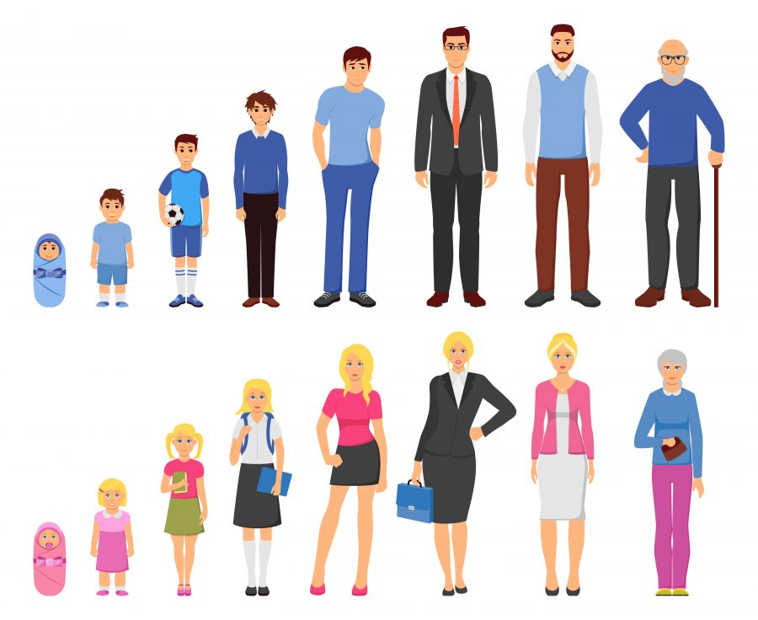
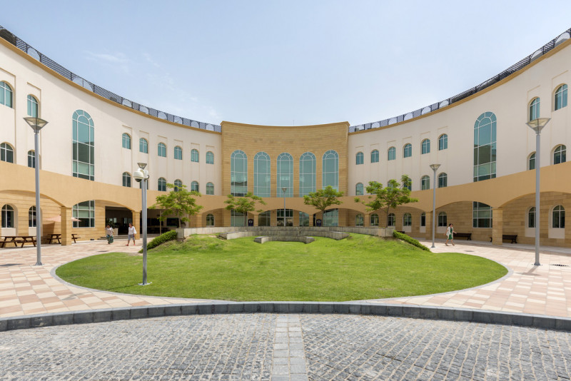
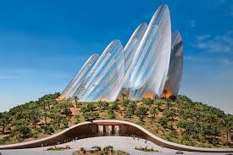
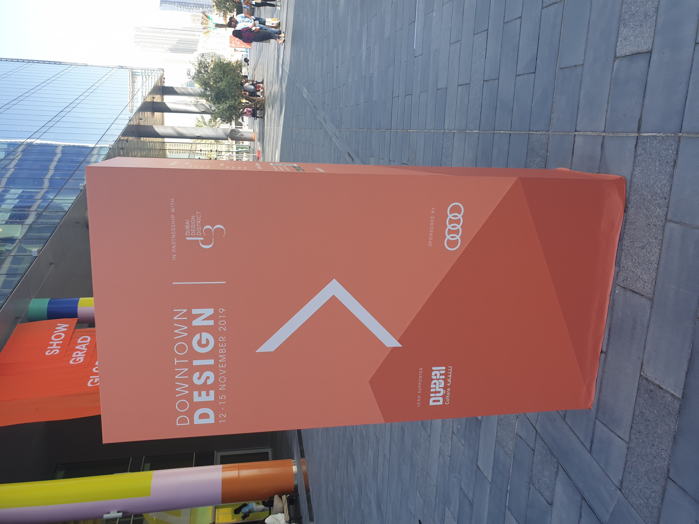
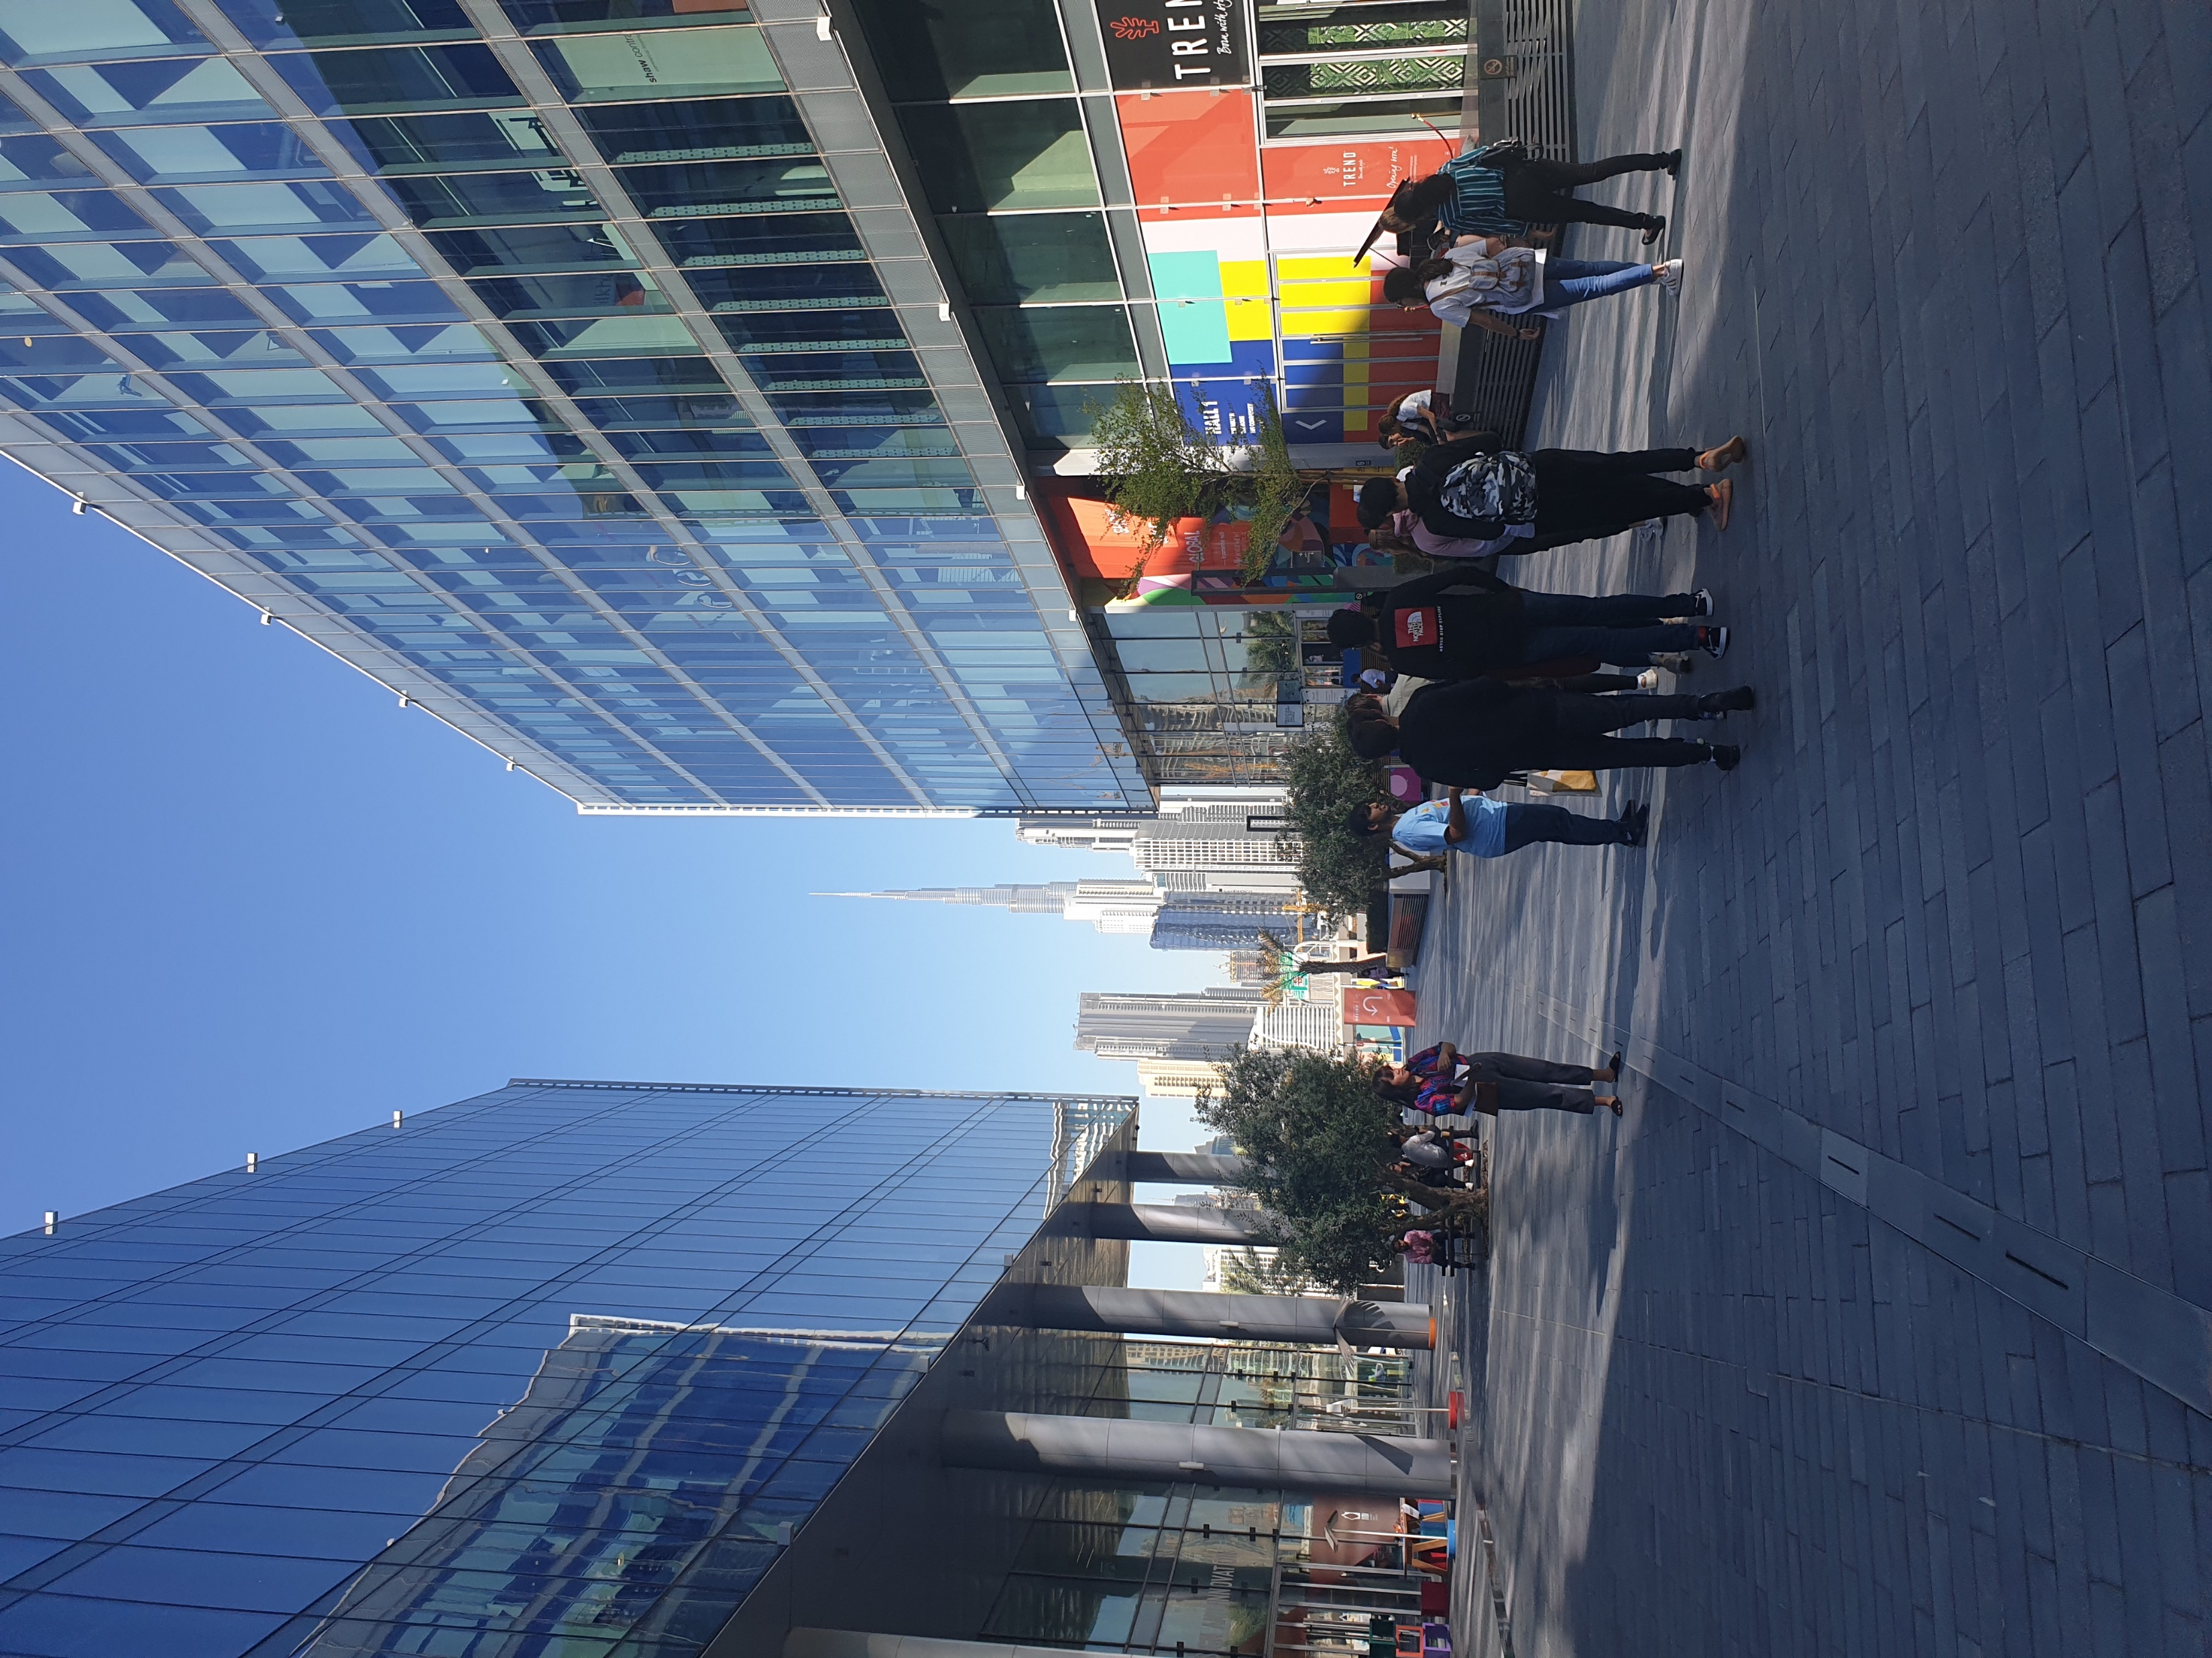
Introduction
Infants ( <1)
Children( < 11)
Quantity of awareness
Quality of awareness
Teens(12-17)
Who
Adults(18+)
A product to increase the awareness of climate emergency
Elderly(65+)
What
Lack of awareness
Why
How can products be used to increase our awareness of climate emergency?
A product for an advocate of climate emergency
Lack of urgency
Lack of movement
Where
When
How
From the 1st of June 2020 to the end of March 2021
Conveying a sense of urgency
Qualitatively
Quantitively
Qualitative information
Schools (Brighton College Abu Dhabi)
Museums (Zayed national museum)
Exhibitions (Dubai design festival)
Colours
Getting the user’s attention
Outdoors
Hallways
Classrooms
Interests

Slide 6
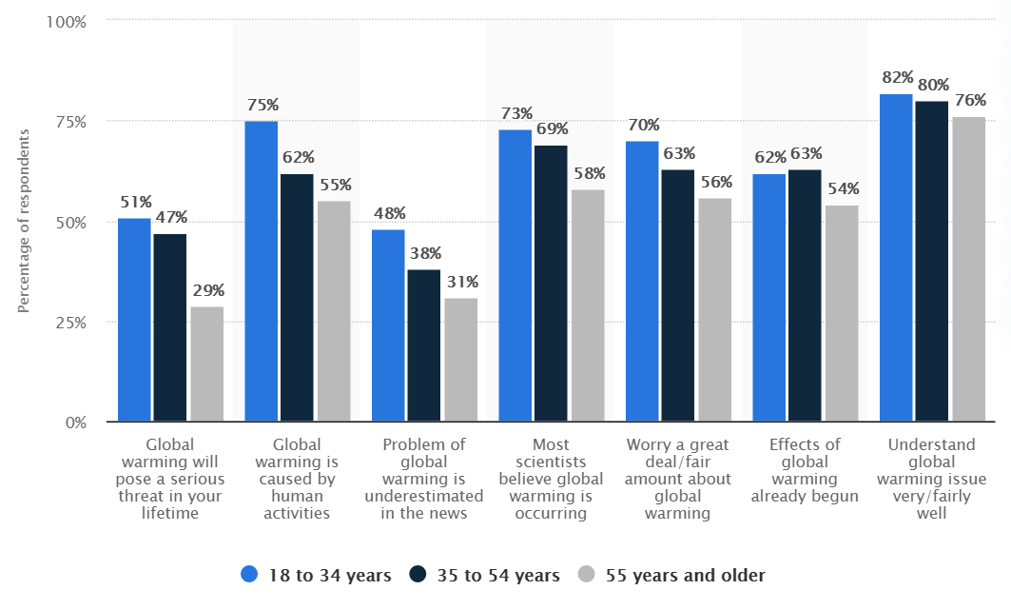
Introduction
I will be researching the possible users and select the end user that I will specifically target. Also, I will identify the needs of the end user.
How can products be used to increase our awareness of the climate emergency?
What is climate emergency?
In declaring a climate emergency, a government admits that global warming exists and that the measures taken up to this point are not enough to limit the changes brought by it.
Identify the needs of the end user: The users (or audience) could be potentially anyone. So I ask the question “who should the product target?” To answer this there is a need to divide the users into user groups and research each of them. Prior to research, I have divided the user groups arbitrarily as shown:
0-6
7-11
12-18
19-24
25-54
55+
I have not considered gender as to be a significant aspect. (even though there were studies about women making more sustainable decisions, I could not find any evidence that supported how gender could affect the awareness of the climate emergency.) Therefore, my product would be gender neutral.
After research I removed some from the list or merged several into one.
According to Stanford Childrens, children at the age of 12 start to think deeply, develop their own view of the world, question authorities and society’s standards and have increased thoughts about global concepts. This would be important as the awareness of age 0-6 are too young for “global” scale. For 7-11-year olds, Campaign Against Climate Change suggests they should be aware of climate awareness followed by a survey results: “68% are interested in learning more about the environment” and “4% of students feel that they know a lot about climate change”. Therefore, I excluded the age of 0-6 and merged 7-18 as a ‘students’ user group.
As shown in the graph (Source A) from Statistica, from the age of 18-34 people are aware of global warming(based on the assumption that the awareness of global warming would be similar to the awareness of climate emergency) compared to the other age groups. However, the age groups of 55 years and older had a significant lack of awareness in terms of how it would be a threat in your lifetime despite the fact that climate emergency has already been declared all around the globe and is a serious issue. Ages of 18-34 would be removed from the list as I find their level of knowledge fine at the moment.
I now have a shortlist of the target user groups:
Students (mostly age 12)
Adults 35+ (focusing on age 55)
Since I am more closer to students, and as I am a student beforehand, I decided that it would be much easier to draw outcomes from the former than the latter.
In conclusion, I have chosen to make a product that will increase awareness of climate emergency to students, especially 12-year olds.
To effectively establish the problem, there is a need to obtain more information about the demographics. The information I would need is:
How many students have heard of climate emergency?
How did they hear about climate emergency?
What is their depth of knowledge about climate emergency?
Has anyone every looked up climate emergency on their own?
How serious do they think about climate emergency?
Do they have any interest in environment and nature?
What are their current interests?
Have they put anything into action?
<Source A>

Slide 7
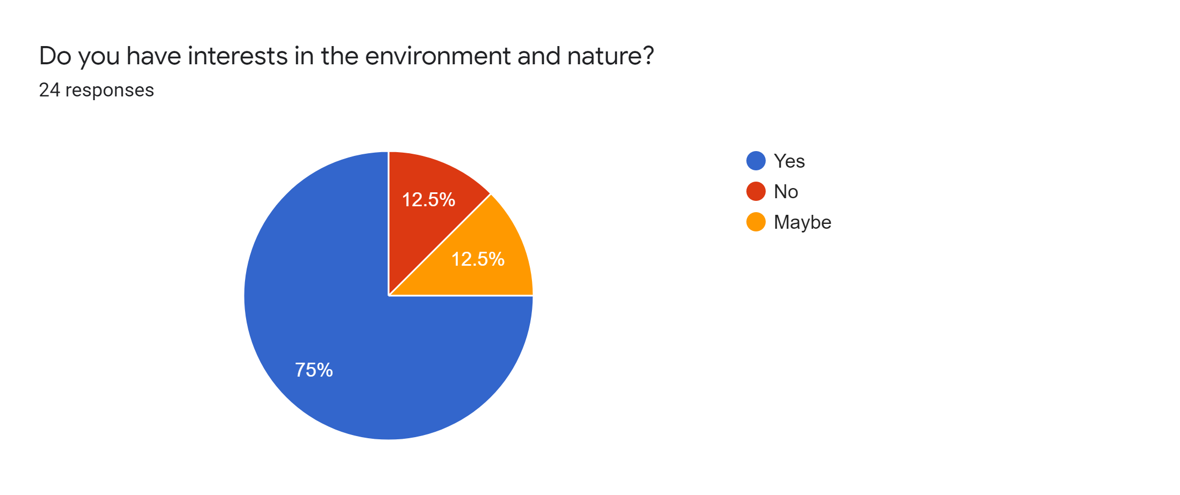
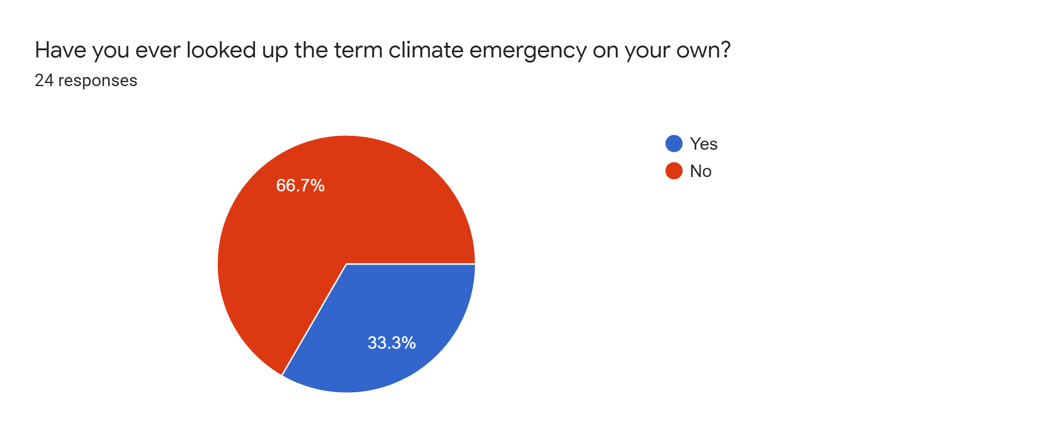
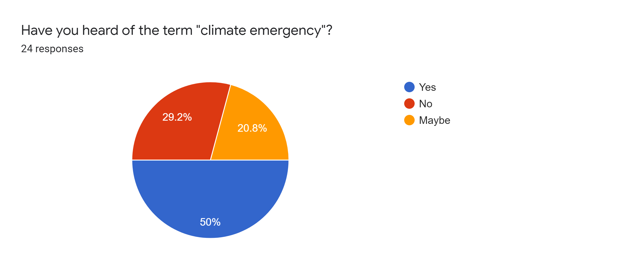
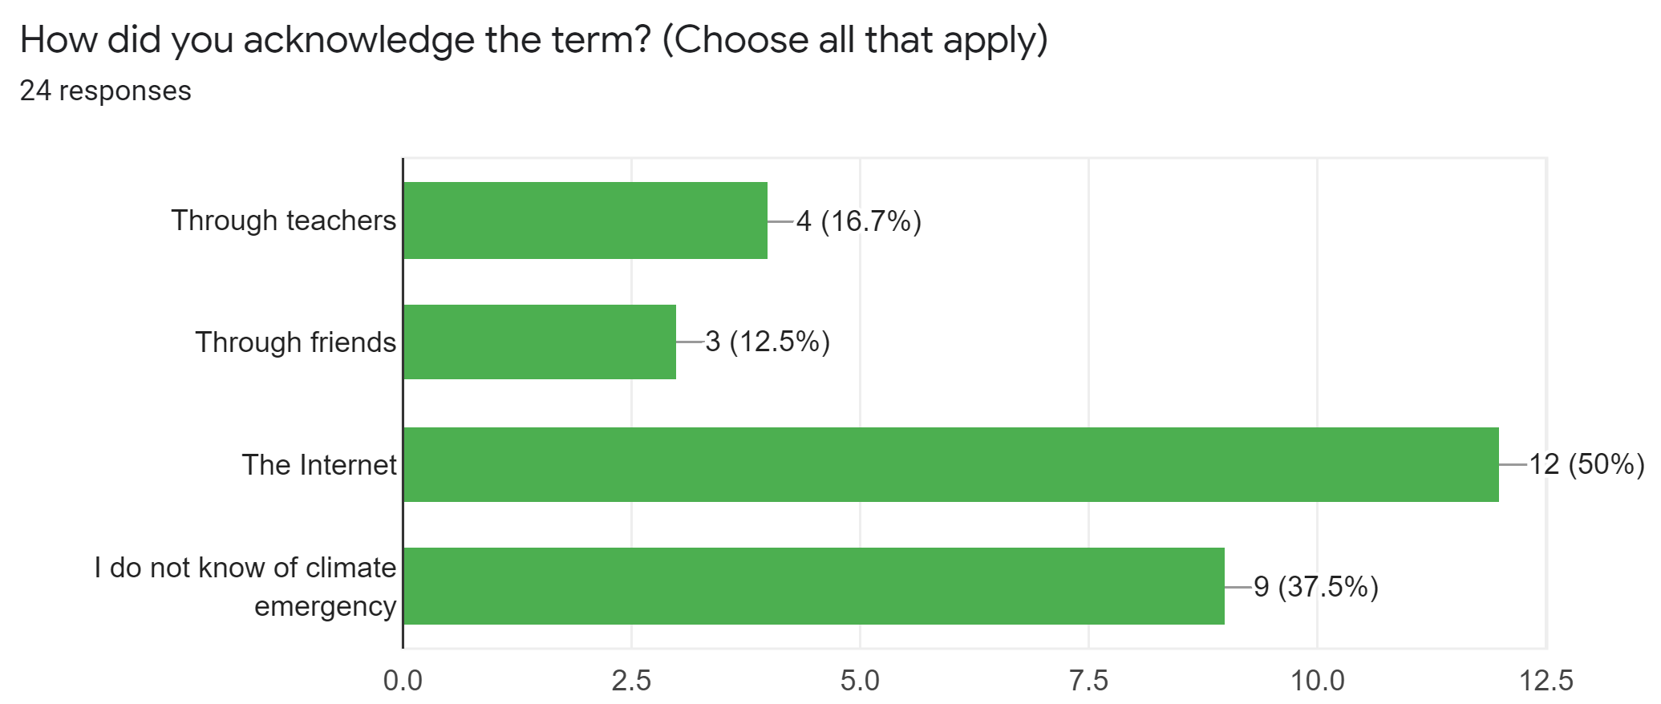
Investigation
The goal of the investigation and the results of the online survey will be displayed.
What I should get from this investigation:
The problem with the current situation
The context of the situation
User behaviours that I should consider
What the product should include
With this in mind I have interpreted the results from an online survey using Google Forms.
Survey Results:
Some questions were asked to scale between 1 to 10. For better data reading I have converted them into a ‘1 to 5 scale’ by merging the adjacent values together. Short-answer questions were grouped together in terms of similar answers. Minor activities were classified as “others”.
1. How many students have heard of climate emergency?
<Source B>
2. How did they hear about climate emergency?
<Source C>
3. What is their depth of knowledge about climate emergency?
<Source D>
4. Has anyone every looked up climate emergency on their own?
<Source E>
5. How serious do they think about climate emergency?
<Source F>
6. Do they have any interest in environment and nature?
<Source G>
7. What are their current interests?
<Source H>
8. Have they put anything into action?
<Source I>
Notes:
Make sure <Source F> doesn’t get cut off when printing

Slide 8
Investigation
I will identify a design problem and a need for a product that could solve the problem.
Since source A did not contain survey results from the age group of 12 year olds, I have done a survey to compare the awareness between the first five questions asked. I considered the last two questions not useful for comparison as they did not have a big difference between each year group.
<Source J>
According to source B, half of the responses say they have heard of the term “climate emergency”. However, it is important to note that the other half is unsure or has not heard of the climate emergency.
Source C shows that the most common way of acknowledging climate emergency was via the Internet. More online research says that phone ownership in this age has reached 97%.
As shown in source D, 1 and 4 scored the highest. Regarding that half is unsure or has not heard of the climate emergency, the “1” was an expected result. However, the “4” indicates that even those who knew about climate emergency did not know fully. Therefore, the product should include depth in knowledge.
Source B and E suggests that even though people have heard of the term climate emergency, they do not look it up themselves. Therefore, it is crucial to have a product that draws the users’ attention to be actively engaged.
Source F shows that for about 54% think climate emergency is a serious issue. On the other hand, 46%, which is a lot, do not think so. This means, the product should be able to convey the urgency of the situation.
Source H provides a guideline on how I could get my end user’s attention. As shown, games, school subjects, art, and physical activities are some of their common interests. Other interests include, cooking, reading and listening to music.
According to source G and I, it is safe to say that the majority of 12 year-olds have interests in the environment and take action. Some of their eco-friendly actions besides reduce, reuse, and recycle include turning the light off during the day and using sunlight through the window and using a search engine called “Ecosia” that helps plant trees. These sources mean that they have high potential for putting what they learned into practice. Which means it is crucial to inform them about how they could contribute in the climate emergency situation.
Some ways they can contribute based on my secondary research are:
Traveling responsibly
Eating sustainably
Shopping differently
Saving energy in homes
Supporting organizations dedicated to climate emergency
Minimizing waste
Recycling
What it mean by traveling responsibly is for example, to travel short distances by walking or riding a bike instead of car. Also, what it means by eating sustainably is to eat locally and seasonally while reducing meat consumption. Shopping differently refers to shopping products that are sustainable. (FSC etc)
In source J, there are two points that are not consistent. The first has a gradual diminishing pattern. The second and fourth is around a similar level with no big differences, However, the third graph is inconsistent with a high value. But as thinking “global warming is underestimated in the news” is a good thing, I would not touch on that point. The other inconsistent graph is the fifth. This graph shows significant value difference. Not even half are worried about global warming. Like the interpretation of source F, it is important to convey urgency.
According to my secondary research, tactics to give a sense of urgency are:
Scarcity
Countdown
Loss of aversion
Time-related wording
Appeal to the responsiveness instinct
Use of numbers
HubSpot supports the idea that using warm colours – red, yellow, and orange – are linked to action

Slide 9
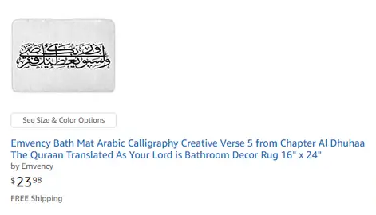
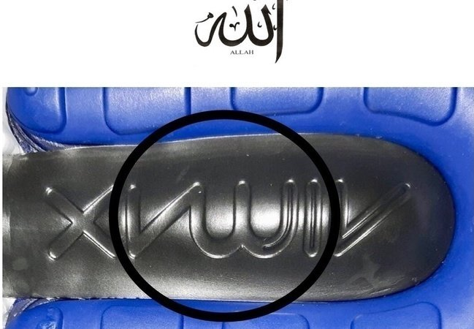
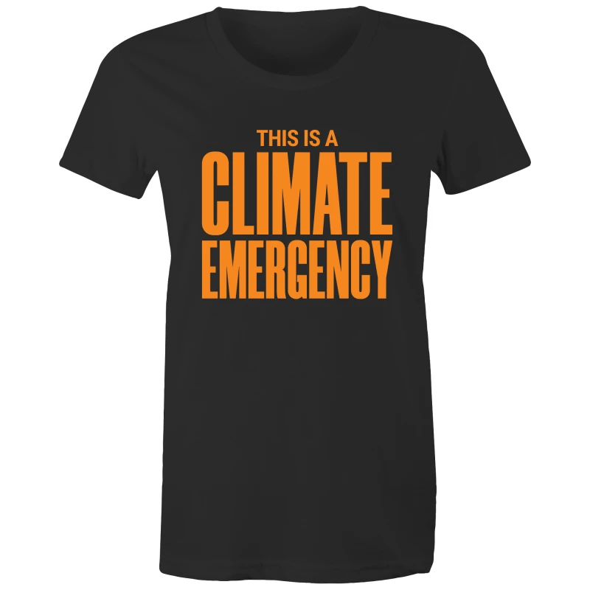
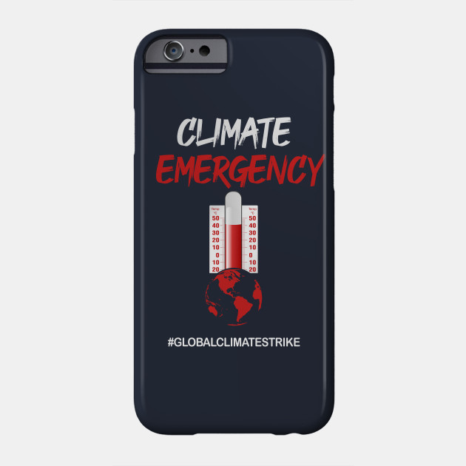
Investigation
Further investigation about the market will be done.
Besides the survey, I have done some Internet research to answer a few more questions.
What method of approach should my product take?
I have divided the possible methods of approaching my demographic into three.
Self → Mass
Product → Mass
Products → Individual
What I mean by each term is that the first one is an individual that chose to buy a product, such as a climate emergency t-shirt, to increase awareness. The second term refers to a single product that many people can see and interact with. The last term means the same product, like cheap pens with printed text or power banks, is produced in large quantity and is given out to each individual.
Since the three methods differ greatly in terms of manufacture, function, and the secondary client, it is key to determine which methods are possible and which methods are not.
The first option is deleted due to the following reasons. This method cannot represent the product’s function fully. This method has a prerequisite of having the “self” to use the product. This limits the product’s usability. Similarly, coming up with the product designs would be restricted as it has to be light enough to be portable: compared with plastic or textiles, wood is a relatively heavy material. Furthermore, it would be challenging to implement an interactive feature with these restrictions.
The third option is also not a viable method. Usually this method involves mass manufacture of hundreds of the same product. Not only that it is difficult to achieve within the limitation the workshop, secondary clients, who would be buying the products, would not buy an expensive product. My price range would be highly narrowed down to about £0.06 (wooden pencils) to £10.3 (power banks) per product. This price range is based on businesses, my client would be NGO(run on donation funds)’s or schools. Unlike businesses, they do not make profit from brand awareness. Therefore, a more realistic range would be from £0.06 to £3.09 (15 AED water bottle). With this range, it would be better to give up on this option.
Hence, the only option left is the “product to mass” method.
How should I design my product?
The product would be used multiple times, targeting multiple end users. Therefore, the product should be able to last as long as possible. Also, because the product encounters many different people, the product should consider cultural and ethical factors. I should also consider that the country I am in is the UAE, which is a religious country. I should be careful not to be offensive when designing the product.
Some past examples of failing to meet the needs of the user were:
Bath mats, doormats and toilet covers featuring the Islamic scripture
Nike Air Max logo unintentionally resembling the “Allah”, the Islamic god
Alternatively, the product could be designed in order to resemble representative images of the climate emergency.

Slide 10

The User
The end user profile will be made. Also, to have my product design more fit with the aim, I will be making a new user profile of those who will be buying my product.
End User profile:
Age Group:
The end users of the product would be
mainly 12-year olds
Location:
Located in Abu Dhabi, UAE
Interests:
Games, school subjects(geography, language, maths, science, etc), art and physical activities are some common interests. Some minor interests are cooking, reading and listening to music.
General behaviours:
97% owns mobile devices
Likely to practice after learning something.
Not worried as much as adults.
Brief description of design requirements.
draws the users’ attention to be actively engaged.
should be able to convey the urgency of the situation.
should not be an offensive design
Should include methods on how to contribute in the climate emergency
Should be based on the anthropometric data of the target demographic
Anthropometric data
Why commission my product?
Among my demographic, half is unsure or has not heard of the climate emergency. This product would be used to aid their knowledge and increase awareness.
Cost Limitation:
The student would not be the ones to buy the product. It would be the secondary client.
The Secondary Client:
Schools and organisations that are willing to increase the awareness of the climate emergency.
Design requirements:
The product must be effective in increasing the awareness of the climate emergency.
Cost Limitation:
£600
If it is a single product, the cheaper product would be preferable.
Time scale/allocation
From the 1st of June 2020 to the end of March 2021

Slide 11
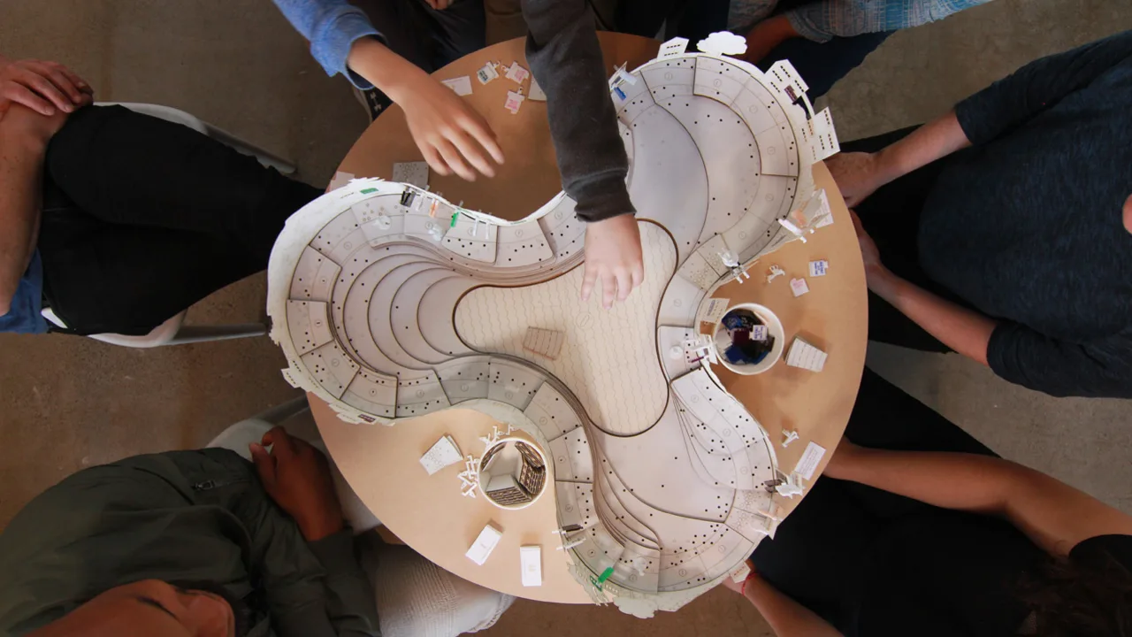
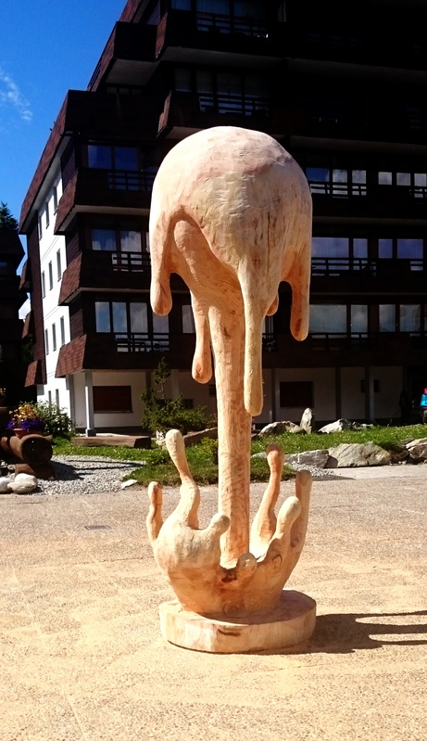
Product Investigation
Investigated existing products that were based on the “product to mass” method.
The colours represent advantages and disadvantages.
1. Bartertown – a game of social resilience to climate change
Aesthetics: The curves and the simplistic design is aesthetic.
Consumer: The product is a boardgame which involves active engagement. In-depth knowledge can be acquired by playing the game. Requires other players in order to play. During the game, the climate change takes place, which can consequently convey urgency. To players work out a way to alleviate the situation, which provides users specific ways to contribute.
Cost: Not more than £50 as it is mainly made with MDF which is a cheap material
Environment & Sustainability: The adhesive in the MDF makes it harder to recycle. Can be recovered as fuel. Some of the MDF could be reused as the product doesn’t contain that much decoration.
Size: About 10cm x 130cm x 130cm
Safety: It has curved edges. It is heavy and bulky for a boardgame. Also, it is not foldable. This increases the chance of being dropped or bumping into other objects.
Function: A boardgame based on climate change.
Manufacture: The computer aided design was sent to the CNC machine and it cut up the MDF into each parts for the boardgame. This method is fast and accurate compared to human manufacture. Cartridge paper is used to make cards and small design features.
Materials: Coated MDF, cartridge paper
2. Wooden Sculpture representing global warming.
Aesthetics: It is made as an artwork. The wood grains may seem appealing.
Consumer: The product cannot provide in-depth knowledge. The product cannot be used to interact. However, the design may be intriguing and have a deep impression. The melting expression of the Earth makes the situation seem urgent.
Cost: £6,060.60 (too expensive)
Environment & Sustainability: The wood can be recycled or recovered as fuel. The wood could also be reused as this product has large areas where it has not been decorated. As the product is not expected to be replaced, it has a long life expectancy.
Size: 210 cm x 60 cm x 60 cm
Safety: It may tip over.
Function: It alerts the audience about the urgency of the current climate emergency situation.
Manufacture: The wood is sculpted. This means there would be a lot of waste material.
Materials: Wood

Slide 12
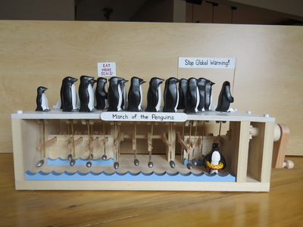
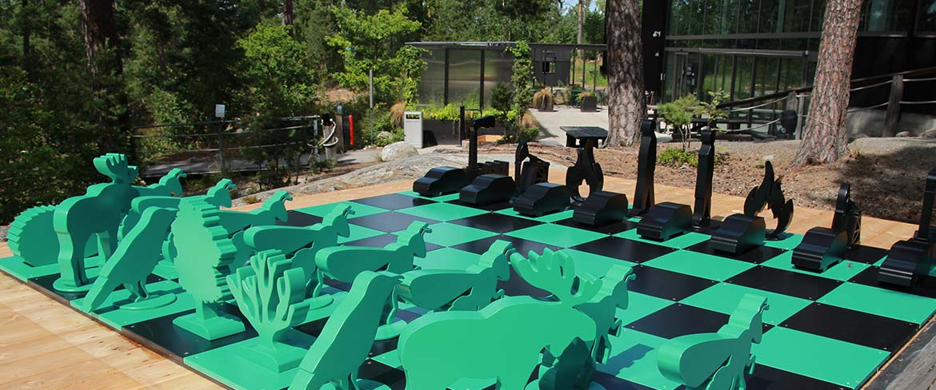
Product Investigation
Investigated existing products.
The colours represent advantages and disadvantages.
3. Automata
Aesthetics: The figures may appear appealing to users. The wood grains may also be an aesthetic factor.
Consumer: To activate it, the crank must be spun. This is a form of activeness. Also, the motion of the penguins can draw attention. Delivers the clear message of needing to stop global warming. Does not provide in-depth knowledge.
Cost: ranges from £10(build kit) to £720(high-quality automata)
Environment & Sustainability: The wood can be recycled or recovered as fuel.
Size: About 15cm x 10cm x 20cm
Safety: The hand may get pinched while spinning the crank.
Function: When the crank is spun, the cam spins. This interacts with the follower and creates the intended animation.
Manufacture: The automata frame would have been made easily by cutting and fixing the surfaces with dowel joints. The cam and the follower is made and assembled. The dowel for the shaft uses stock materials. Therefore, less waste is produced.
Materials: Wood, metal wires.
4. Climate Chess
Aesthetics: The simple design and the colour contrast is appealing.
Consumer: The product is interactive as it is based on a chess board game. However, it requires an opponent to play against. The iconic chess pieces give a good impression of the climate change due to human behaviour. Does not convey urgency.
Cost: N/A
Environment & Sustainability: The product’s expected life time is very long. This means less waste.
Size: About 60cm x 8m x 8m(too big)
Safety: There is not much pointy bits. However, the metal sides can be sharp. A person could trip when going on the chessboard.
Function: An outdoor chessboard with the chess pieces representing two sides: the nature side and the industrialisation side.
Manufacture: The chess board is made with plywood as it is a strong material. The metal is shaped into each chess piece.
Materials: Plywood, metal.

Slide 13
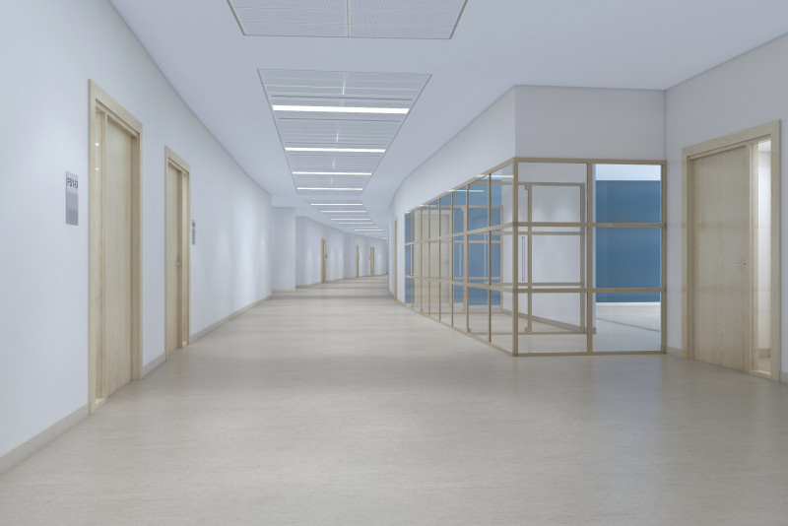

Factors to consider
Will obtain user feedback to have better understanding of the demographic and to put in account when coming up with initial ideas. The context of where the product would be investigated.
User Feedback:
For each of the existing products from the previous page, I have interviewed my demographic about it.
1. Bartertown – a game of social resilience to climate change
Does not seem entertaining
Too big and heavy to carry around
I do not want to spend time learning the game rules
2. Wooden Sculpture
Does not look like Earth nor melting Earth
Looks like water droplets
With no distinctive colours, it is hard to identify from far away
3. Automata
It is cute
It may break due to misuse
May be better with sound, like a music box sound
The mechanism looks dangerous as there no blockage in between
4. Climate Chess
Would rather play football
Its difficult to recognize each chess piece
Can trip because of the pieces
It is too hot outside in the UAE
Based on the user feedback, I have decided that outdoors is not a good option due to the hot weather and that it would likely be neglected if it was not big enough. Ideas like boardgames should have intuitive rules and decent portability. Products should be stable and safe during use.
Where the product would be used:
The products were to be used out of the three locations: outdoors, in the hallways, and in the classrooms. However, based on user feedback, I have decided to remove the “outdoors” option.
Theses are the locations in the school where the product would be used.
In the hallways
In the classrooms
General:
Though the UAE is hot and humid, both products would be indoors with the right temperature and humidity.
Hallways:
The advantage of this option is that
many people would spot the product as
they walk through the halls. It should be
stable and designed with exceptional
situations, such as people bumping into
it, in mind. Also, the product should be
able catch attention. To achieve this, it
is beneficial to have at least one feature
out of sounds, lights, or a size big
enough to be seen from far away but
not to disturb hallway traffic. If it gets
bigger, it should be strong enough to withstand its own weight and the possible force of the user leaning on to it.
Classroom:
It should be resistant to big bumps and
occasionally some drops as it would be
moved around a lot. This contextual
background is suitable for ideas like
boardgames. Likewise, classrooms
have chairs and desks which allows
the end user to sit down. Therefore,
the interaction time with the product
could be longer compared to standing
up. The objects inside the classroom
would limit the size of the object.
Moreover, it should be strong to
withstand cases where the users exert force from above proportional to their weight.
Similarly, the product should be easily carried around. As a result, it is best to have the product smaller than the desk and lightweight as possible.
How I would measure awareness:
Currently there is no way to figure out both conscious and unconscious thoughts of one’s mind. This means, “awareness” cannot be measured quantitively. As a result, I would have to interview users after they use the product or prepare quizzes to check if they have learnt anything. I could also attempt to interview users after some given time to know how effective the product is in the long-run.
Notes:
Images to be replaced

Slide 14

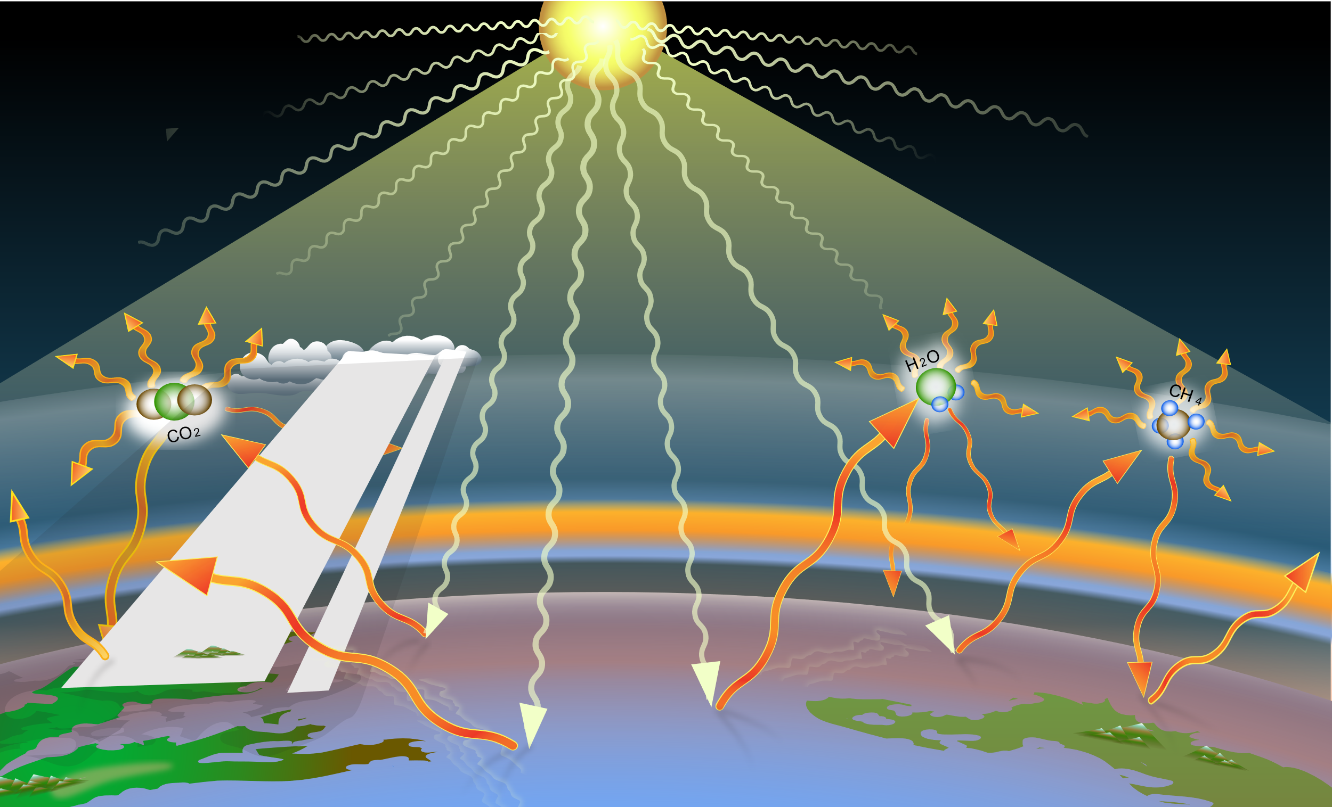
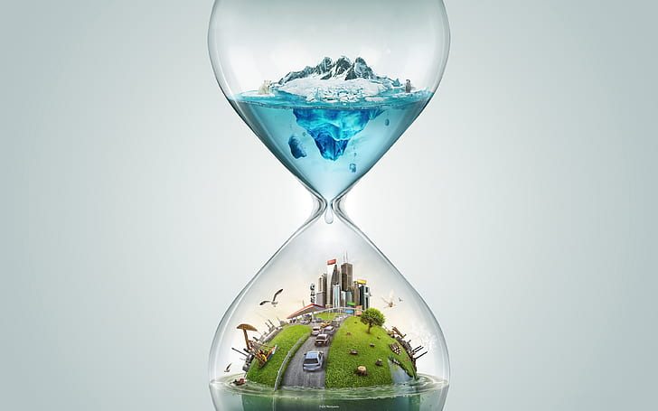
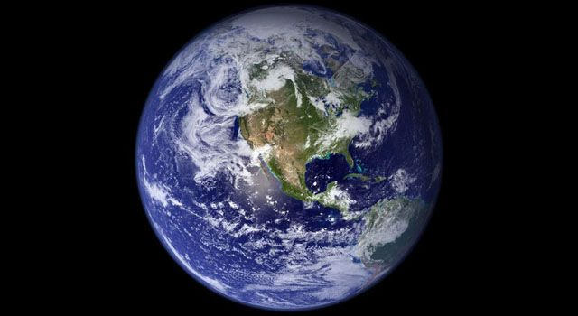
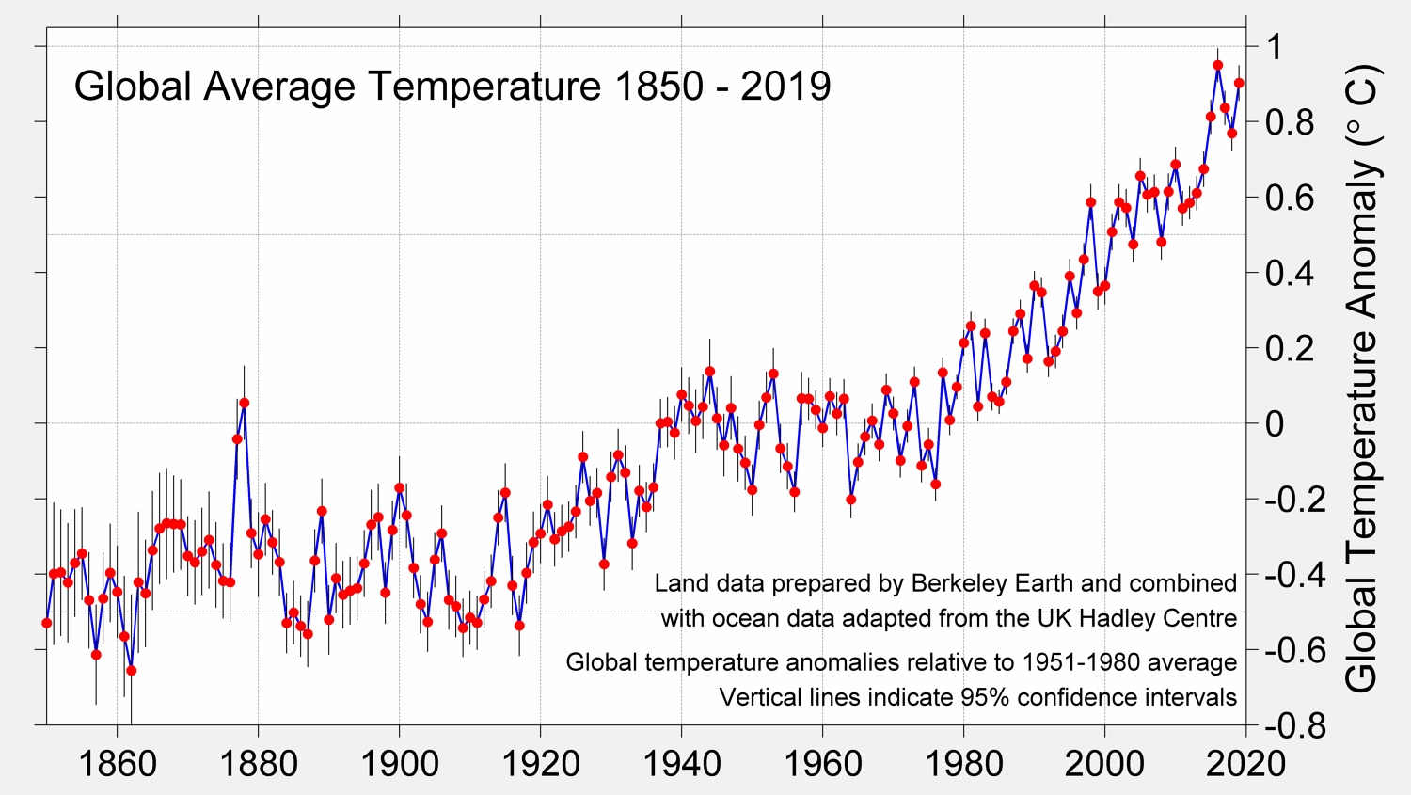
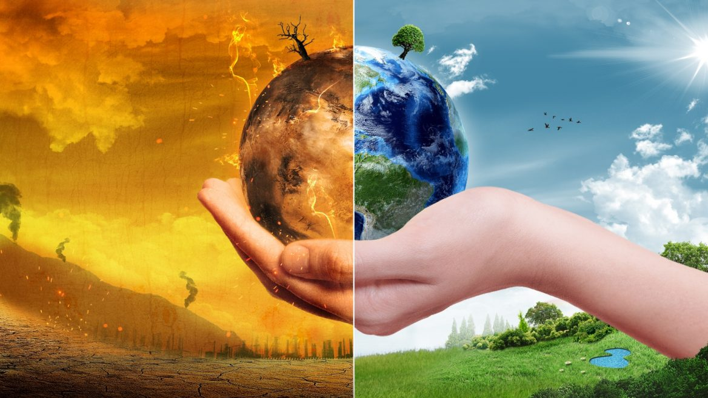
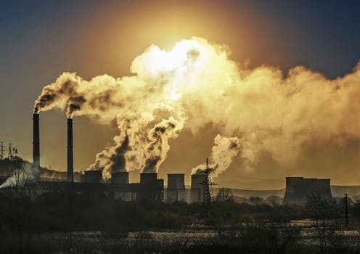
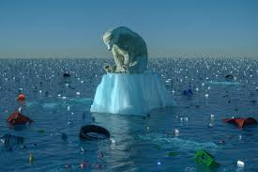
Factors to consider
I will research other limitations.
Other limitations:
Materials:
I am limited to use materials and equipment in the workshop. Since the workshop has mostly timbers, my product would be based on timbers.
Cost:
Mentioned on the user page.
Service:
The product could be shipped internationally. This can be possible if they can understand the direct or implied meaning of the product. To understand it though, language and culture may have to be similar.
Colours:
As the product targets multiple people, it should not include colours or designs of a particular user request. Instead I would use colours associated with the Earth such as green, blue, and white to increase the effectiveness of the product. As I said before I would use warm colours related with action and can successfully convey the urgency.
Design:
It should be safe to use. For a safe design:
Anthropometric data can make sure that the product is the right size for the intended user or range of users.
The product should not involve users in excessive physical effort
Ideally a product should be suitable for use by small (5th percentile) women as well as by large (95th percentile) men
Gaps and clearances should suit the user
The product should be evaluated under the same conditions as it will be used in
The product should be comfortable and easy to use. This can be checked during trials by asking users what they think about products through a structured experiment or questionnaire. Checklists can be used to ensure that all aspects of design and use are assessed.
It should be suitable for the demographic based on its anthropometric data
Also, the part where the user interacts should be scratch-resistant(hard) for longer use. As referred to in the second investigation page, it should have a design that resembles climate emergency to aid the understanding of the end users.
Such examples of the representative images can be:
Melting earth (This option psychologically makes the situation urgent)
Greenhouse gases (Acknowledges that humans have caused global warming)
Rising temperature (This option psychologically makes the situation urgent)
Hourglass (This option psychologically makes the situation urgent)
Catastrophic Earth (This option psychologically makes the situation urgent)
Industrialisation (Delivers the sense of guilt, Acknowledges that humans have caused global warming)
Melting artic (with polar bears, causes empathy)

Slide 15
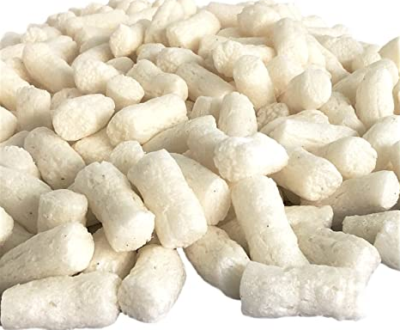
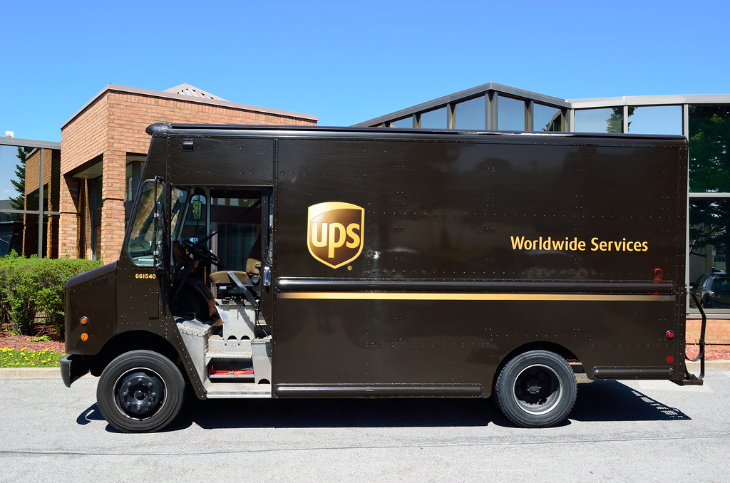
Shipping
I will discuss the packaging and shipping process of the product.
Where will this product be sold?
Referring to “Other factors > Service” the language problem is not a big problem since 1.5 billion out of 7.5 billion people, which is about 20% of the Earth’s population, speak English. Also, due to globalisation, the culture difference is not that big. Therefore, the product would be designed in the UAE and shipped to English speaking countries. Through other countries are in consideration, I would majorly target the UAE demographics. A translation version of the product could be made for wider language support.
How will it be shipped?
The product will be shipped through UPS courier. The price will be dependant on the region it would be shipped to.
Domestic shipping - £39.99
Europe regions - £82.04
the USA - £94.62
other regions - £ 90.08
Sustainability issues concerning the transportation:
According to the Global Footprint Network, the UAE has the largest per capita ecological footprint in the world, so I would try my best to minimise the ecological footprint.
Before the product is shipped, it would have to be packaged. The product would be placed in a cardboard corrugated box. This is because corrugated boards are inexpensive and can easily be shaped to fit the necessary dimensions. To ensure safe transportation of the product, if the product has “sticking-out parts” such as the legs of a chair or has unnecessarily large empty areas. I will consider my product to be designed as a knock-down fitting. Otherwise, I will be shipping the full product. Likewise, I will be filling it with some soft materials to protect the product.
Some ways to package products are:
extruded polystyrene foam(EPS) also known as Styrofoam
polystyrene peanuts
bubble wraps
As all three ways are petroleum-based I had to look up some alternative packaging that was eco-friendly. What I found was corn starch packing peanuts. Suggested from the name, they are packaging peanuts made from corn starch, which makes it biodegradable. This method is a great alternative of the previous polystyrene which had big ecological footprints and could not be easily decomposed or recycled. However, it does have some limitations. The “great alternative” only works for products that are not heavy. The heavier the product, the more it “squishes” the corn starch packing peanuts. If the product is too heavy, then it would not be able to get a cushioning effect.
For my case, the product would be made out
wood. This means, even though the product
is heavy overall, it would have a relatively
large surface area that would distribute the
force. In conclusion, my product would be
using corn starch packing peanuts as a
packaging material.

Slide 16
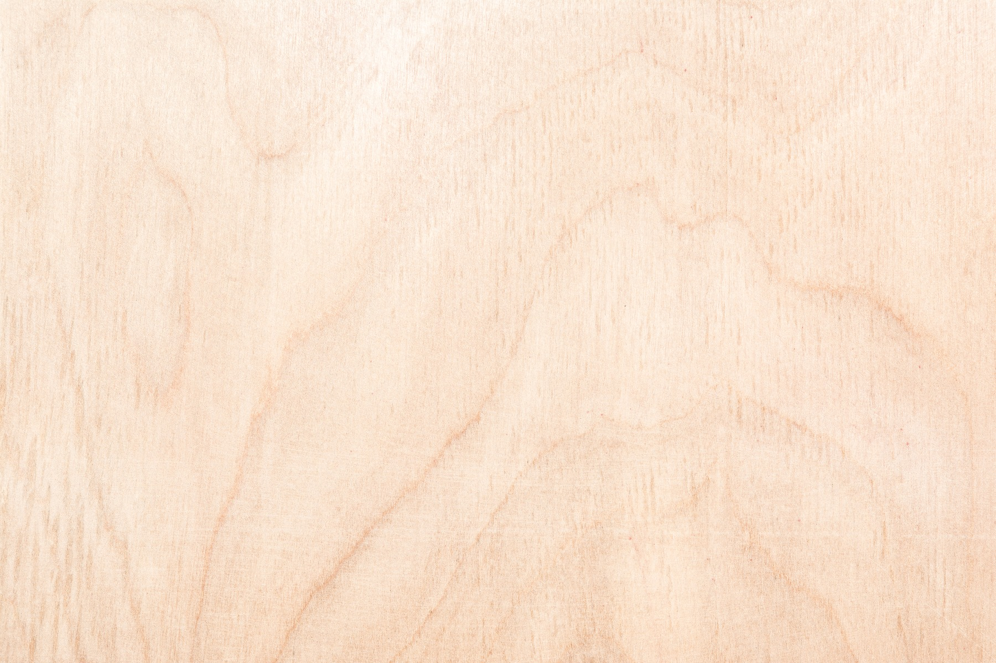
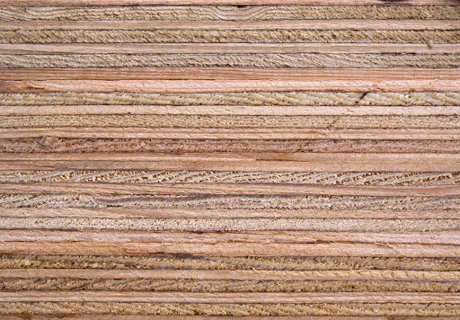
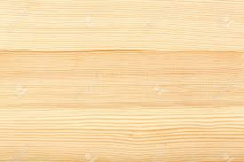

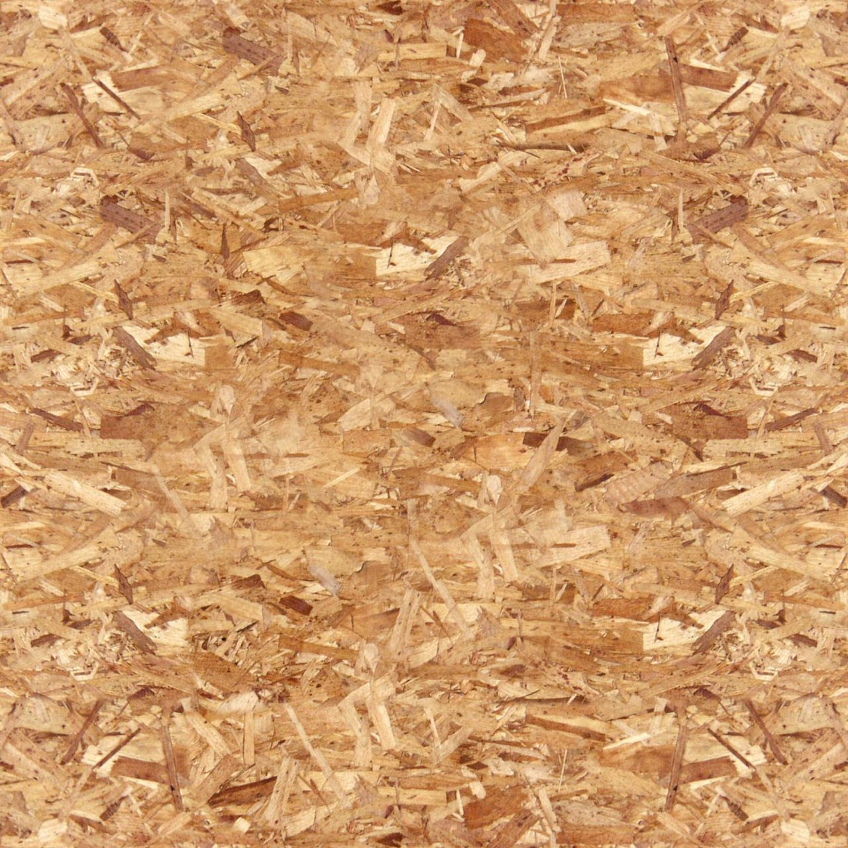

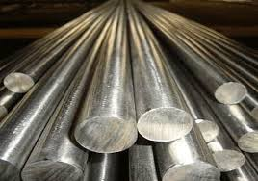

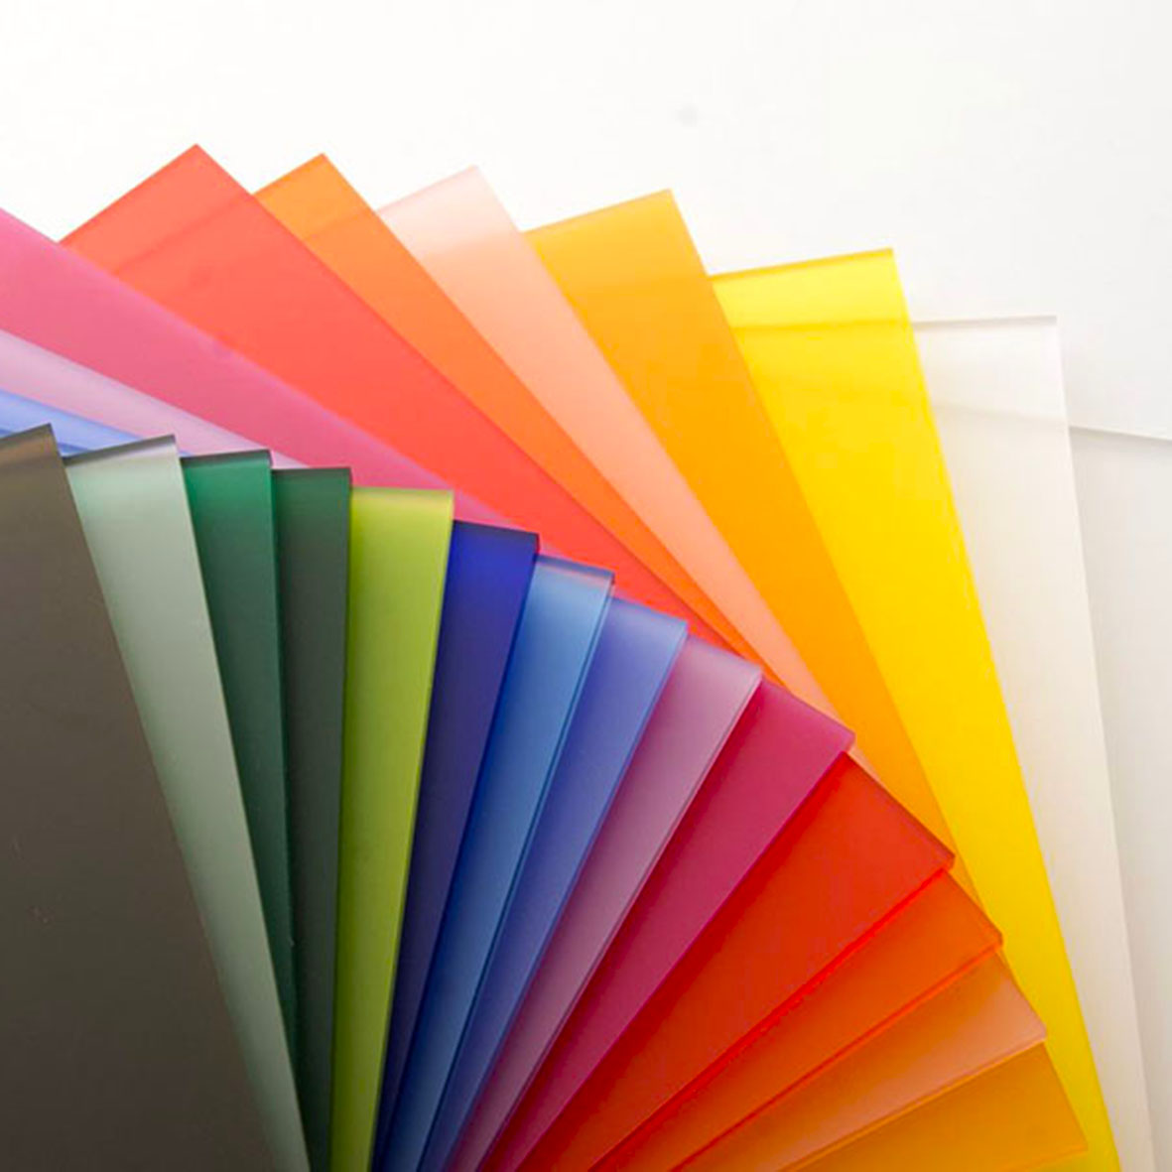


Material Research
On this page I will be researching possible materials that I could use to design my product.
The colours represent relevant advantages and disadvantages.
Mentioned on “Factors to consider > Other limitations > Materials” I am limited to my workshop materials. I will be listing the available and relevant materials. Since I have already considered the exposure conditions on “Factors to consider > Where the product would be used”, all is left is to find an appropriate material for each conditions.
Hallways: Hard to be resistant to slight bumps and scratches. Strong
Classrooms: Tough in case of drops and big bumps, hard to be resistant to slight bumps and scratches. It should be lightweight. It should be strong
Both situations does not need to consider humidity or temperature conditions. Cost should be a minor factor. The timbers from the workshop are all from sustainably managed forests. Although, sustainability would not be a big concern, it is best to choose a durable timber or a recyclable material to decrease waste over a given time.
Manufactured Boards:
Manufactured boards use timber to make a board that has different properties to plain timber. Is makes it possible to acquire boards that are larger in diameter than a normal tree trunk.
Plywood
Plywood in manufactured by gluing veneers with the grain lines going in alternate directions. This makes it flat and structurally strong. Due to this, it is resistant to warping, cracking and twisting. The veneers are actual pieces of wood, so the surface looks like wood. Because of these properties, it is commonly used for building and furniture panels that need some strength. Despite the numerous advantages, it has disadvantages. It is quite expensive and the edges could look rather rough. Also, it is prone to water damage if wrong grade is used.
Medium Density Fibreboard (MDF)
This manufactured board is made up of waste material such as wood dust and fibres and glue which makes it sustainable. It is pressed into flat sheets under extreme heat and pressure. As it is made from waste wood the cost is cheap. The smooth ungrained surface is good for painting and staining as well. Though it is easy to machine, tools may blunt quickly due to the glue. To add, it is weak in compared to real wood or plywood and does not look good, so needs coating. These properties make it commonly used for cheap flat-pack furniture, wall panels, display cabinets, and storage units.
Chipboard Chipboards are wooden chips mixed with glue pressed into flat sheets. It is sustainable as it uses waste material. Hence, the cheap price. It is used for desktops, kitchen worktops and cheap flat pack furniture. It has some disadvantages as not having much structural strength, especially in damp conditions. Additionally, the surface is very rough, so it is usually plastic coated.
Other Materials:
Mild Steel
It is a composition of iron and carbon. It is tough, ductile, malleable, magnetic, and easily joined. It has high tensile strength, but poor corrosion resistance. Therefore, it is best to keep it hidden or the corroded material would appear unattractive. Some applications of this material are screws, nails, bolts, girders, and car body panels.
Acrylic
It is a thermoplastic that has good impact strength, but breaks easily if dropped. It can be easily finished as it does not require painting and can be easily shaped using heat. On the other hand, it is susceptible to scratches. It is available in forms of sheets, rods and tubes with a variety of colour and opacity choices. It is not recycled as much.
High-impact polystyrene (HIPS)
It is a lightweight thermoplastic that has high stiffness and is impact resistant. However, it can be easily scratched. It is important to note that it becomes brittle when exposed to UV light. This material is also available in forms of sheets, rods and tubes with a variety of colour and opacity choices. It is not recycled as much.
Pine
Pine is a softwood used for roof joints and floorboards when constructing a house. It is also used for furniture, doors, and interior woodwork. It is a very durable wood and is quite cheap as it grows quickly. It is reasonably strong, lightweight and easy to work with. On the other hand, it can warp, crack and splinter more than some other woods. Likewise, it is prone to scratches and dents and can be easily damaged. Pine often features knots and knotholes which should be considered before working with the wood.
Oak
Oak is a strong and durable hardwood which was used for building houses and boats in the past. Now, it is used for high-end furniture and wine and whisky barrels. It has an attractive grain when well finished and is resistant to wear and tear. However, it is expensive and hard to work with than some woods. Moreover, it is a very heavy type of wood and can corrode iron and steel.
Beech
Beech is a hardwood that is usually used for making toys, cooking implements, and solid and laminated furniture. Some advantages of this wood is that it is tough, hard and does not crack or splinter easily as it has a straight close grain. Additionally, it withstands shocks and wear. But there are some disadvantages. The high density of the wood makes it heavy and difficult to work with. It is expensive and not very resistant to moisture as well.
Birch
Birch is a hardwood commonly used for making veneers. This forms plywood and surfaces cheaper materials that are used for interior door and furniture. It is inexpensive and lightweight. Though it has regular, even grain and is easy to work with, it has low resistance to rot and insect attacks. Also, birch wood is hygroscopic. This makes the wood susceptible to warps and cracks in a dry environment.(This includes indoor use.)

Slide 17
Design Brief & Specification
Design Brief:
After all the investigation I have decided to work on a product that targets students, mainly 12 year olds, as they are unaware of the climate emergency. The product would target students by using the “product to mass” method, as described on “Investigation > What method of approach should my product take?”. It would have to draw attention of the user, convey the urgency of the situation, include methods on how to contribute in the climate emergency, and ultimately increase the awareness of the climate emergency. The one’s purchasing my product would want it to be affordable and effective.
Assessment Criteria:
I will come up with initial ideas that would be suitable for the contextual situation. Then I would produce a prototype of each. The prototype will then be assessed based on these specifications. Each specification is awarded a certain value depending on its importance: must (+3), should (+2), and could (+1). By adding up the points, we can see if the prototype is successful or not. Depending on the context of where the product would be used, the specification may vary. Due to the difference in total points, the assessed points would be represented as a percentage. The product would also be assessed by user feedback. The user feedback would be obtained in a scale of 1 to 10 and then recalculated as a percentage. The final rating would be out of 100, while 75% being the specification and 25% being the user feedback.
Specification Area | Specification Point (Hallways | Classrooms) |  | Reference | Explanation
Function & Performance (A) – (Total points: 13) | A1. The product must convey the urgency of the situation A2. The product must use the “product to mass” method A3. The product could be linked with mobile devices. A4. The product should be stable during use. A5. The product should provide in-depth knowledge A6. The product should provide methods to contribute in the climate emergency. |  | A1. Investigation > Source F and J A2. Investigation > What method of approach should my product take? A3. Investigation > Source C A4. Factors to consider > User feedback A5. Investigation > Source D A6. Investigation > Source G and I | A1. The product should use at least two of the tactics listed in “Investigation > Source J” A2. As explained in the reference A3. Any link with mobile devices would be acceptable. A4. To be stable is to be still enough not to interfere with other functions of the product.(Wobbling may affect the user’s focus) A5. The product should have a section where the user can know more than just what climate emergency is. For example, the cause or future consequences. A6. The product should list at least two of the methods from “Investigation > G and I”
User Requirements (B) – (Total points: 13) | B1. The product must make users aware of climate emergency. B2. The product should draw the user’s attention to be actively engaged. B3. The product could be linked with user interests. B4. The product must not be targeted for outdoor use B5. The product should be intuitive to interact with |  | B1. The User > The secondary client > Design requirements B2. Investigation > Source B and E B3. Investigation > Source H B4. Factors to consider > User Feedback B5. Factors to consider > User Feedback B6. Factors to consider > Where the product would be used | B1. Will be measured according to “Factors to consider > How I would measure awareness” B2. If B3 is awarded a point, then this should be as well. If not, it should be determined by the user interaction time. It should be longer than 10 seconds for any first-time user. B3. One or more from “Investigation > Source H” would be acceptable. B4. As explained in the reference B5. To be intuitive is for the user to know how the product works without previous usage. This would be measured using user interviews. B6. An appropriate force would be exerted to test if the product is able to resist it.
 | B6. Should be able to withstand leaning force. | B6. Should withstand force exerted from above.
Notes:
Not seriously attempted at the moment

Slide 18
Specification Area | Specification Point (Hallways | Classrooms) |  | Reference | Explanation
Form (C) – (Total points: 7) | C1. The design/colours should be gender neutral. . C2. The design must not be sensitive in the eyes of the public. C3. The design could be representative images of global warming. C4. The product could use colours associated with global warming. |  | C1. Introduction > Identify the needs of the end user C2. Investigation > How should I design my product? C3. Factors to consider > Other limitations > Design C4. Factors to consider > Other limitations> Colours | C1. I will interview both boy and girl and determine depending on their responses. C2. I will interview users and ask about any sensitive topic related with the design. C3. Some representative images are shown on the reference page. C4. Some colours associated with global warming are shown on the reference page.
Sustainability (D) – (Total points: 8) | D1. The product should be durable D2. During production, as little waste possible should be produced. D3. Materials used should be recyclable D4. Packaging should be corn starch packing peanuts |  | D1. Material Research D2. The product should have a good LCA D3. Material Research D4. Shipping > Sustainability issues concerning the transportation | D1. The main building material should be durable. D2. As explained in the specification point. D3. All materials used for the product should be recyclable. D4. As explained in the reference
Safety Precautions (E) – (Total points: 7) | E1. The size of the product could be based on anthropometric data. E2. The product should have curved/smooth surfaces E3. The use of the product should not involve excessive physical effort. E4. Gaps and clearances should fit the user. |  | E1. Factors to consider > Other limitations > Design E2. A general way of making a product safe to use. E3. Factors to consider > Other limitations > Design E4. Factors to consider > Other limitations > Design | E1. If G1 is awarded, E1 is also awarded. If not, E1 is not awarded. E2. Applies for every edge and corners. E3. This will be awarded depending on the user feedback. Though without the user feedback it could be determined by using it myself. E4. Gaps and clearances should only be used where the user is aware and necessary. Else, it is best to keep the surface smooth.
Scale of Production (F) – (Total points: 7) | F1. The product must be under the cost limitations. F2. If needed, the product should be designed as a knock-down fitting F3. The product should be batch produced. |  | F1. The User > The secondary client > cost limitations F2. Shipping > Sustainability issues concerning the transportation F3. No reference. | F1. The total cost should be calculated and compared with the cost limitations. F2. As described on the reference page, if the product had “sticking-out bits” or is a bit bulky, it should be designed as a knock-down fitting. F3. My workshop limits me to one-off or batch production methods. As I will be making the same products and shipping them internationally, jigs, moulds and templates are needed for faster production.
Size (G) – (Total points: 3 | 4) | G1. The size should be suitable for the demographic based on its anthropometric data |  | G1. The User > Anthropometric data G2. Factors to consider > Where the product would be used > Hallways G3. Factors to consider > Where the product would be used > classroom | G1. The height of the product should be justified by the use of anthropometrics. G2. Big size the better in terms of grabbing attention. It could be as big as long as it does not disturb the hallway traffic. G3. The bottom area of the product should be smaller than 18 x 24inches or 45.7cm x 60.96cm
 | G2. It could be of a big size. | G3. The size should be smaller than of the desk.
Material & Component Requirements (H) – (Total points: 10 | 14) | E1. Materials must be available in the workshop E2. Product must be made mostly of wood E3. The product should be hard E4. The product should be strong |  | E1. Material Research E2. Factors to consider > Other limitations > Materials E3. Material Research E4. Material Research E5. Material Research E6. Material Research | E1. The product should be made of workshop materials E2. The main material of the product should be wood E3. A hard material should be used in a place where it can be the most effective . E4. A strong material should be used in a place where it can be the most effective E5. A lightweight material should be used in a place where it can be the most effective E6. A tough material should be used in a place where it can be the most effective
 | None | E5. The product should be lightweight E6. The product should be tough
Assessment Criteria:
The total score for the “hallways” specification is 68 and the total score for the “classroom” specification is 73.

Slide 19
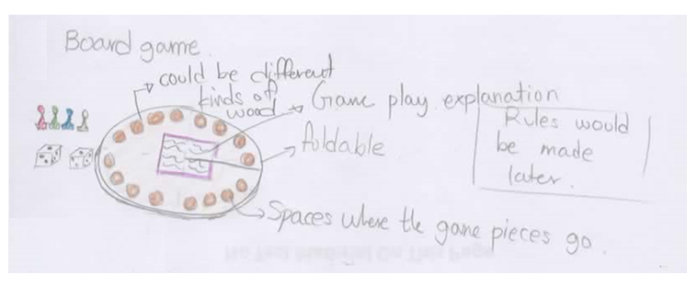
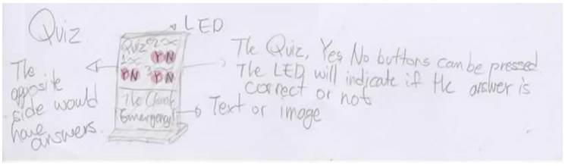
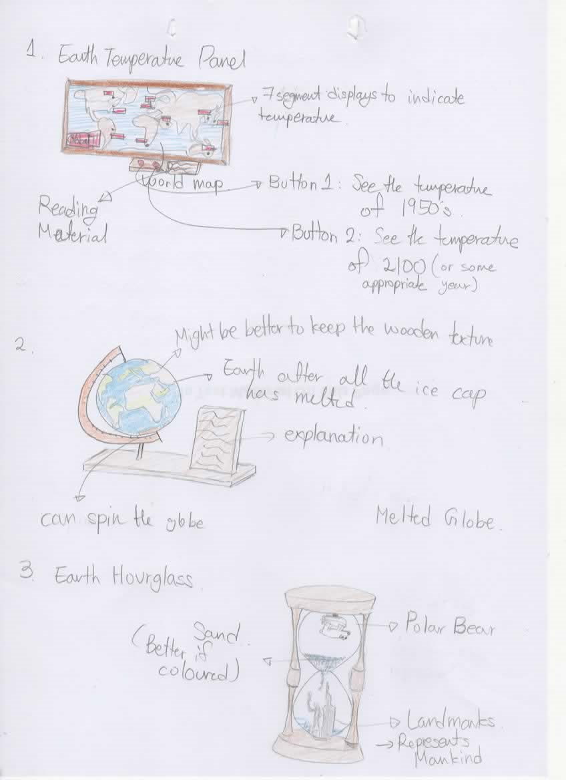
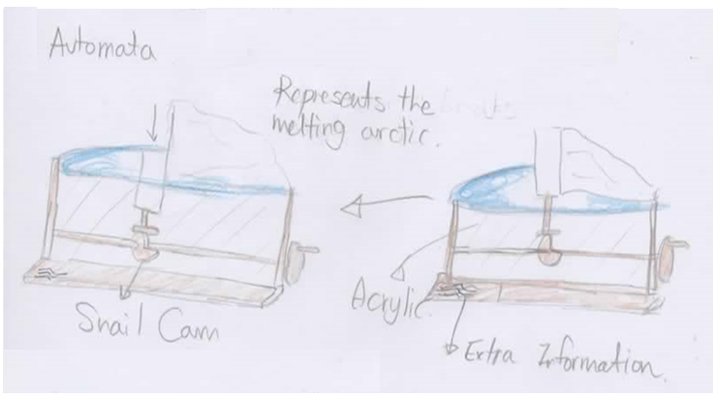
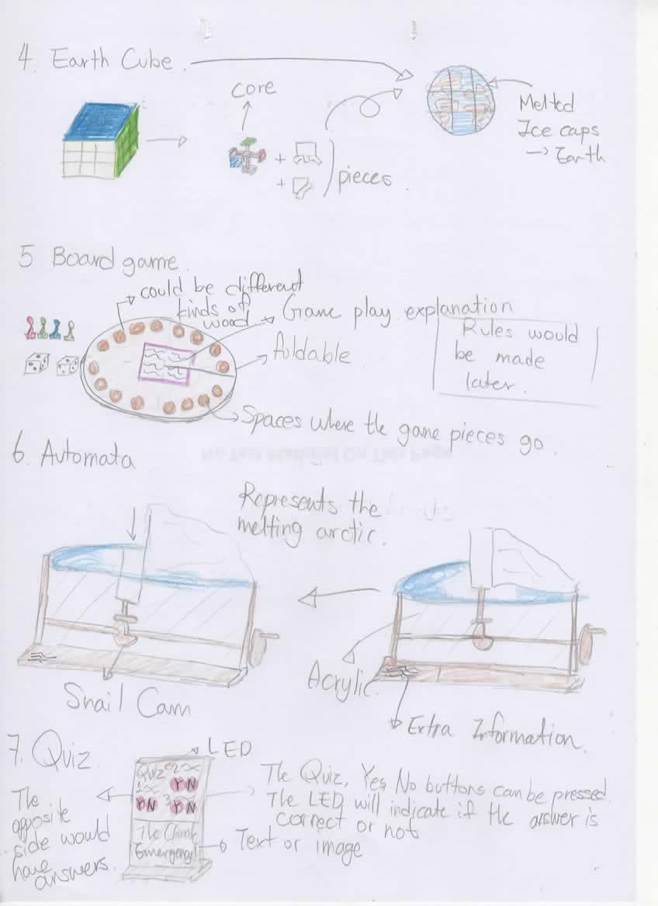
Idea development
On this page I will be brainstorming possible ideas for my product.
I have come up with seven ideas I have drew each idea in its most basic form and written a brief description of what it would do. Then I have interviewed my demographic to figure out which ideas they think are interesting and what ideas are not.
The result of the interview suggested 3 design ideas:
A globe of the Earth after the ice caps have all melted.
The Earth temperature panel/map
An automata

Slide 20
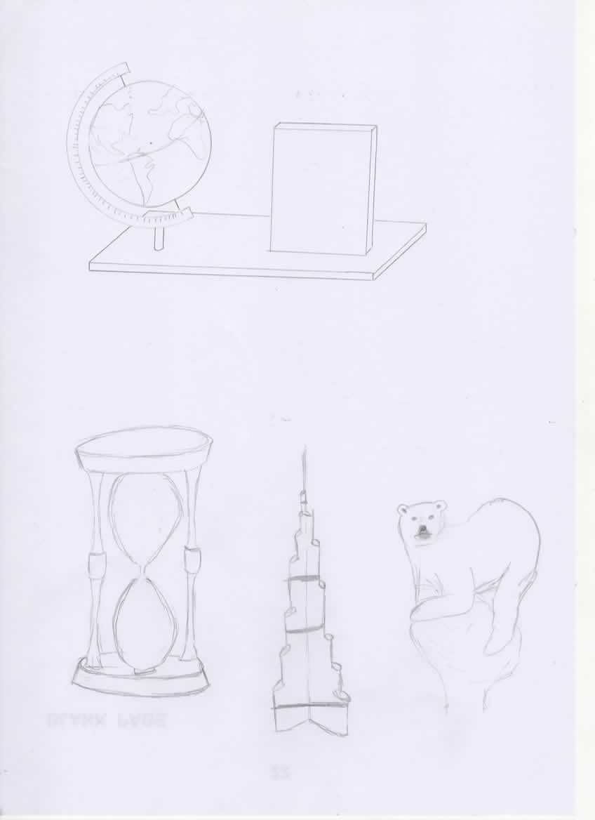
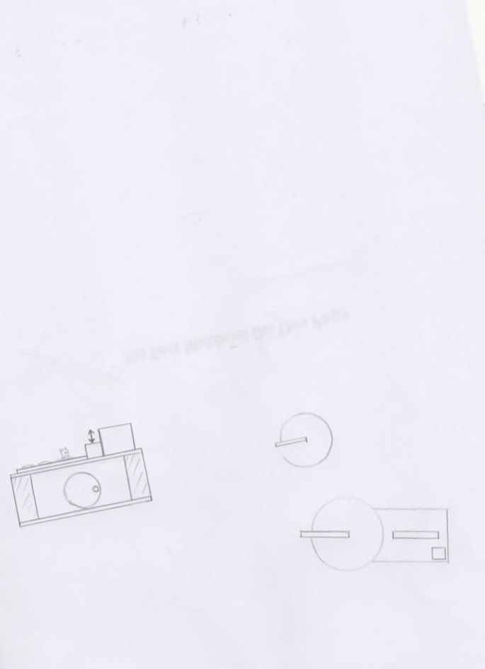

Design 1
The design for the Melted Earth Globe.
This would be used in classrooms.
Budget
Budget is not a big concern. However, to reduce the costs, the mainboard would be of veneered plywood. The globe would be made of PVA-glued oak.
Sustainability Issues
It would be more sustainable as instead of using a trunk of wood to create the globe, it is adding small pieces of wood together. Also, the use of stock materials reduce waste, hence more sustainable.
Components
The globe would have the geographical map of the Earth after all the ice caps have melted. It would connected from the poles so it would be able to spin it while it being slanted.
Components
The information board would be have additional information about the globe on the left and about climate emergency.
Materials
To make the product strong, I would be using veneered plywood for the mainboard. For an aesthetic and durable use of the globe. To make it aesthetic, epoxy resin would be used. The information board would be made of oak to suit the texture of the globe. But the inner part where the texture is would be of MDF. The measurements on the side of the globe would be made of Beech as it should be hard to resists scratches. The connectors between the measurement part and the globe would be bearings made of stainless steel as it is a showing part and it should not get corroded to function longer.
Aesthetics
The wooden globe made of several layers of oak would make it seem aesthetic. The oak grains would be attractive as well. The acrylic resin and the oak would suit together. Also, the connector between the globe and the mainboard would have an appealing shape. The mainboard would be veneered with an oak veneer to have all three components have the same texture. For the QR code, I would have an image of a Oryx.
<Main View>
2cm
8cm
0.6cm
10cm
11cm
Processes and Techniques
Primarily, there is a need to make a template before woodturning the globe. The template would be a guideline for the wood to be turned into a spherical shape. The template could be made as a CAD design and made with MDF via the CNC laser cutter(which our workshop has). The basis of the globe should be made. Small planks of wood could be joined using PVA glue. Then the edges are cut with a handsaw. It would be cut so that the blank would be stable when spun on the wood lathe. The blank would be lathed to fit the size of the template on any part of the sphere. Then I will draw the map(from national geographic website) on the globe with pencil. After I make the line thicker. Then I will use a router to cut the ocean part of the globe. This will be fitted in a acrylic container. Epoxy resin would be made with blue colour pigments mixed inside. The resin would be poured into the mould and would be placed inside an air compressor to get rid of air bubbles. After the resin has set, it would be back on the wood lathe. The plastic container would be scraped off until the inner wood part is fully exposed. The measurements on the side of the globe would be made as a CAD and used to laser cut the timber into the desired shape. The connector between the globe and the mainboard should be wood lathed as well. Then the four are all put together. The information board is formed by MDF with oak sides. The MDF would be painted white and have text printed on it. The mortise where the information board would fit would be made using a mortiser. PVA glue would be used to join the last part. Finally, the wood is smoothened to have curved edges and finished.
13cm
6cm
13cm
2cm
1.8cm
10cm
16cm
Cultural Considerations
The location I am in is the UAE and like other countries has their own national symbols. One of them is the Arabian Oryx, which is the country’s national animal. It symbolises beauty. Considering the factors the image of an Arabian Oryx would go in the middle of the QR code to attract users to scan the code.
Globe
Information Board
<Simplified View>
Mainboard
<Top View>
Components
My product would have a QR code at the bottom right side of the Mainboard right next to the information board. This would link to the national geographic website which I would be getting the geographical map oft the Earth after the ice caps have melted. It has an image of an oryx in the middle.
Generated using Qrcode-Monkey

Slide 21
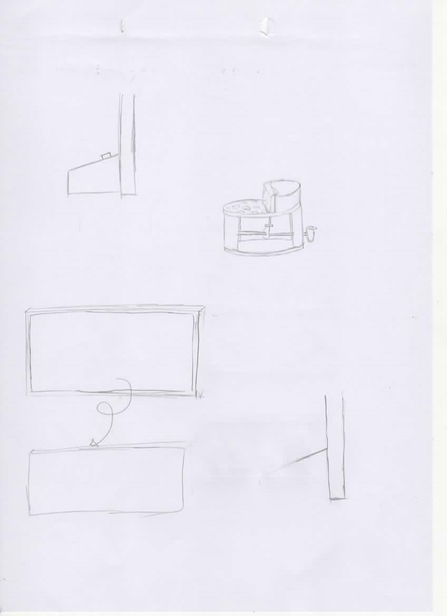
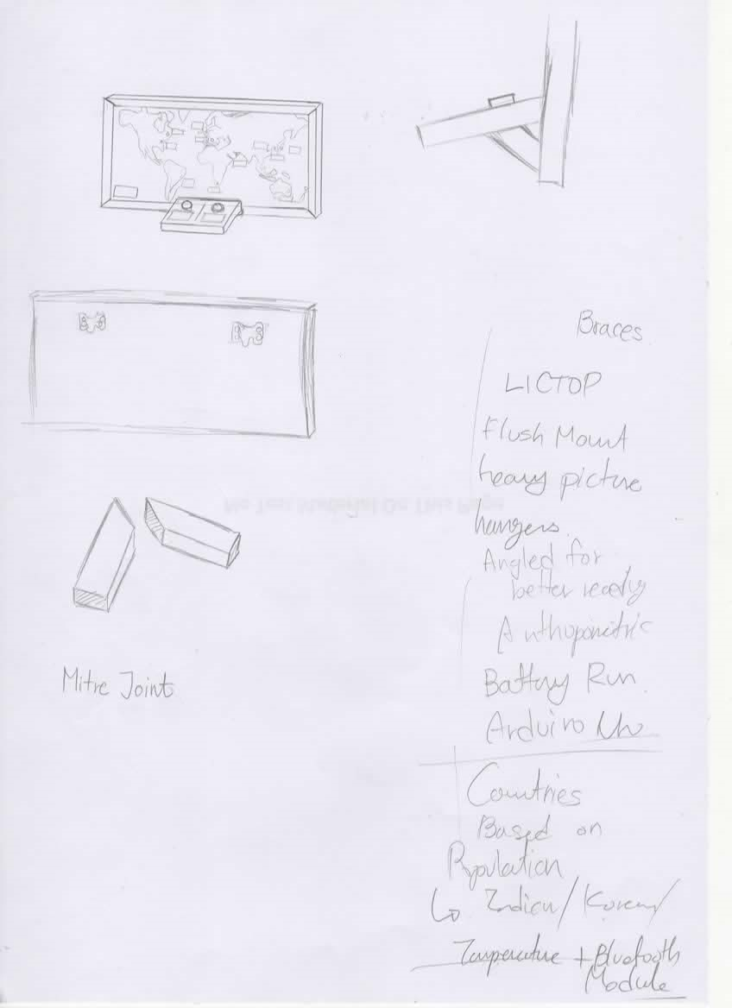
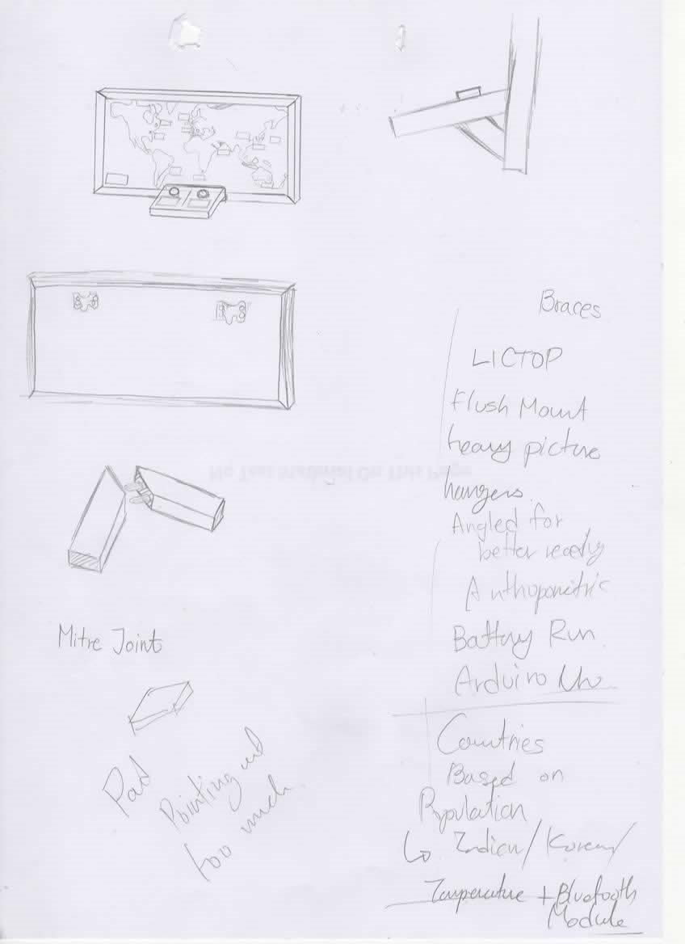
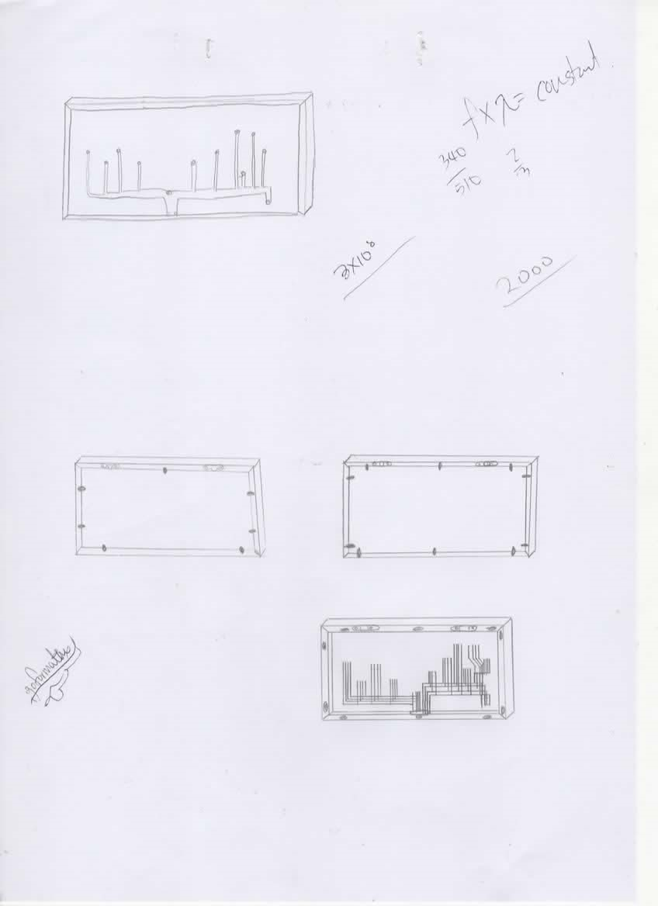
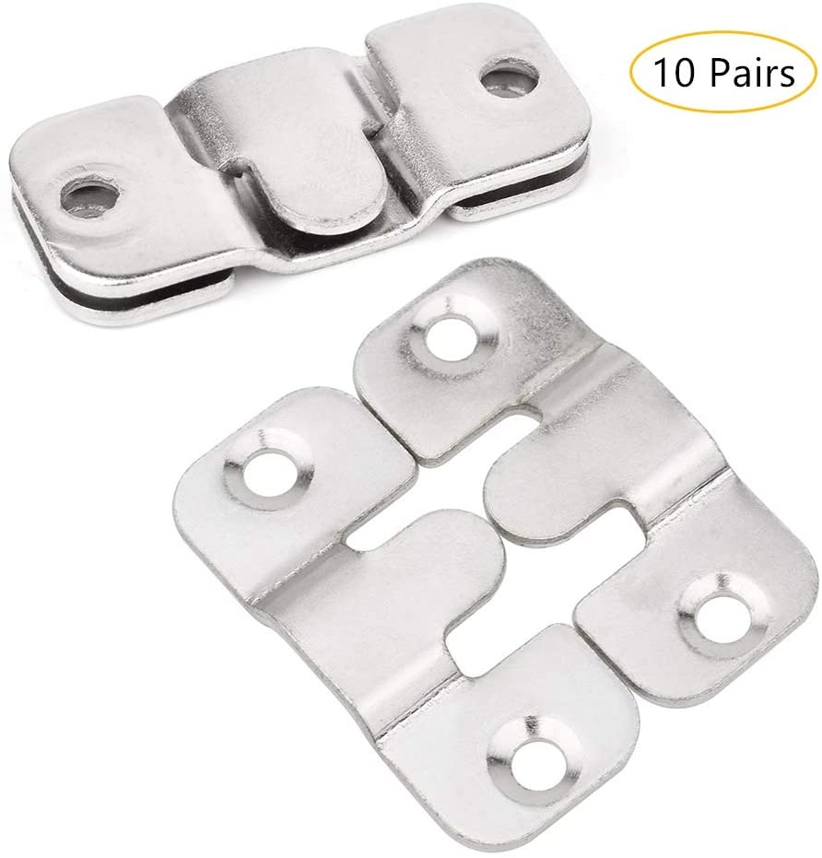
Design 2
The design for the Earth temperature panel/map. This would be a product used in the hallways.
Budget
Budget is not a big concern. However, to reduce the costs as much possible, the back panel(the non-visible part) would be made of MDF.
Aesthetics
This product could be used as a decoration purpose as it is made to hang on the wall like a picture or an artwork. To add, the product would be made of materials with appealing grain structure.(At least for the parts that are visual) Furthermore, our school has quite a lot of student works on the hall, so it would suit perfectly.
Components
The seven segment LED display’s would be used to display the temperature of the cities around the world. It would be based on their current temperature. When the buttons are pressed, the displays would show different temperatures.
Materials
The outer frame would be out of oak as it is durable and resistant to tear an wear. The inner map would be out of birch. It is a inexpensive and lightweight material which makes the picture frame easier to hang. The interface would be of a hard wood: beech. The electric components I will use are an Arduino, shift registers, buttons, a Wi-Fi-card and seven segment displays.
Cultural Considerations
Since the product would be mainly for the UAE people, I would make Arabic translations for the reading material. Initially, I have thought of labelling countries as well as the map. However, the culture I am in does not accept Israel as a country. Therefore, I decided the world map to just have contour lines of the continents without any mention of countries.(I will include cities though). (The UAE and Israel has announced peace on 13 August 2020, but since this is relatively recent issue and that this may not mean the acceptance of Israel as a country I decided not to consider it.)
<Side View>
Processes and Techniques
First I will be making two 46cmx2cmx3cm pieces and two 86cmx2cmx3cm pieces with each of their corners cut at 45 degrees. To minimise waste, I would have the 45 degree cuts connected together. Then, I would only need to make one cut to make two. Next, will use a pillar drill to make four 1cm holes, two for each face. These would be used later to form a dowel mitre joint. Next, I will be creating the inner map. It would be made by joining random lengths of timber. This way it would use left over timber and can be sustainable. After the dimensions are 80cmx40cm, a world map stencil would be placed on top and I would spray paint it. Then on the back side of it, it would be carved to make space for the electric wires which would end up in the interface. The interface would be hollow to have the electric components inside. It would use the mitre joint to look smooth on the outside. In the inside, the electric parts would be assembled and connected. I would use a chisel mortiser to create rectangle spaces to fit the 7 segments. The holes for the interface buttons would be made by a pillar drill with a flat drill bit. The world map, frame, and the interface would be connected using PVA glue. Just in case, the interface would be screwed from the back. The clearance, pilot holes would be made during the process. Next, the back would be covered by a 80cmx40cmx0.3cm MDF. It would be held in place by a small metal piece connected to the frame by a screw. Finally, the sides would be sanded, smoothed and finished
6cm
78.7 degrees
<Main View>
3cm
86cm
3cm
80cm
3cm
40cm
46cm
Components
This button is in red to trigger the activeness of the user. When this button is pressed, the seven segment displays will display the temperature from the 1950’s.
3cm
3cm
15cm
3cm
Components
This button is in red to trigger the activeness of the user. When this button is pressed, the seven segment displays will display the temperature of the Earth after 100 years when there is no action done.
20cm
Frame
World Map
<Simplified View>
Interface
Components
On the back panel of the product, I would attach some flush mount brackets to hang it up on a wall. I would attach one on the right and one on the left to increase stability compared to a single bracket
Components
This has descriptions for what the two red buttons do. Below there would be an English and Arabic explanation about climate emergency, the cause and effects of it, and how the user should participate in the climate emergency.
Sustainability Issues
Sustainable material such as manufactured boards(MDF) would be used. Also, the production would be done in a sense to create the least amount of waste possible.

Slide 22



Design 3
The design for the automata.
It would be used in classrooms.
Budget
As I would be using paint to colour the wood, I would use an MDF for the wood. This is because, it can reduce costs in places where the aesthetic properties of wood is not important. Also, if unnecessary I would not be using expensive wood.
Aesthetics
Since there is a need to indicate that the background of the automata is melting ice, I would be painting them accordingly(ice-white, ocean-black). The main visual appeal would be of oak. The grains would be aesthetic.
Sustainability Issues
I would use stock material to minimise waste. Also, I would use sustainable materials such as MDF. Durable material is used to increase the lifetime of the product, hence the sustainability
Cultural Considerations
The UAE has several significant symbols. One of them Is the UAE national tree, the Al Ghaf tree. It stands for stability, peace and adaptability. It is a great symbol to alert the imminent need for stability and peace within the Earth’s ecosystem. The Ghaf tree leaf image would be used in the middle part of the product to add some local familiarity.
Materials
MDF is suitable to the use of oil-based paint as it has a smooth surface. The base of the product would be of plywood as a structurally strong material is required. Beech and oak could have been used, however, the board would be placed at the bottom of the product which would not take much attention. Hence, there is not need to use expensive materials. The next layer from the bottom where the mechanism is place would be held by two oak blocks. Despite the heaviness of the oak, it is needed as otherwise the product may be unstable. Since there is a big space for air, it would be lightweight compared to its size. For the crank handle bit, I would be using beech to ensure it to be hard and tough.
Processes and Techniques
First the circular base would be made using a jigsaw. The round edges for the middle would be made by chiselling of the edges and forming a polygonal shape. Then it would be filed and sanded to fit into the premade template(to ensure the circular shape). The outer lining would be cut with a jigsaw from the inside and outside to make a lining feature. The MDF for the ocean part of the scene would be 1.2cm. Half would be glued to the outer lining with PVA glue. The ice part of the scene would be made using the methods I used to create the middle part. Then it would be joined as well. I would drill a little hole with a pillar drill for the middle pieces. One would have a penetrating hole and one would only go half way. Then the dowel and cam would be set up so that the animation works properly. The crank and the handle would be made. The handle could be wood-lathed to add a bit of aesthetics. The moving piece would have a flat follower. To go with the cam. An acrylic sheet would be bag pressed to have the appropriate curve. Appropriate gears would be used to have a suitable length of animation. Lastly, the product would be sanded, finished with paint and finishing oil.
13cm
1cm
5cm
0.6cm
0.6cm
4cm
6cm
6cm
0.6cm
15cm
Components
When the crank is turned around, it spins the cam and creates an animation representing the melting arctic ice.
Side view →
Components
This is the ocean part of the scene. It has floating bits of ice that is a result of global warming. There is a polar bear in threat of life. It conveys the urgency of the situation.
Components
There is a small gear connected to the crank handle. This is connected to a bigger gear which slows the animation. The animation would fulfil the “engaging” part of the specification.
<Simplified view>
Components
Transparent acrylic is used to cover the mechanism of the product. It can act as a protection.
Scene
← Top view
Outer lining
Middle
Base

Slide 23
Design 1 Assessment
Design 1 would be assessed using the specification for the classroom products. Blue would be successful points, red would indicate failure to meet the specification.
Specification Area | Specification Point | Explanation
Function & Performance (A) – (Points: 11) | A1. The product must convey the urgency of the situation A2. The product must use the “product to mass” method A3. The product could be linked with mobile devices. A4. The product should be stable during use. A5. The product should provide in-depth knowledge A6. The product should provide methods to contribute in the climate emergency. | A1. The loss of aversion and catastrophe was used. A2. The design was based on this method. A3. The qr code leads the user to a website.. A4. The spinning of the globe is hard without the hand of the user to hold the mainboard in place. A5. It has the information board. A6. It is listed on the information board.
User Requirements (B) – (Points: 10) | B1. The product must make users aware of climate emergency. B2. The product should draw the user’s attention to be actively engaged. B3. The product could be linked with user interests. B4. The product must not be targeted for outdoor use B5. The product should be intuitive to interact with B6. Should withstand force exerted from above. | B1. Since this is an assessment of ideas, it cannot be tested. Therefore I would have to assume that the product is successful at its primary role. B2. The user would spend quite a bit of time playing around with the globe and reading the text. B4. Used in classrooms. B5. As this product is based on a globe, anyone would know how to use it. It is to spin the globe. B6. Since this is an assessment of ideas, it cannot be tested. However, the weight of a 12-year old would be hard for the globe part to withstand with one thin connector.
Form (C) – (Points: 7) | C1. The design/colours should be gender neutral. C2. The design must not be sensitive in the eyes of the public. C3. The design could be representative images of global warming. C4. The product could use colours associated with global warming. | C1. No designs or colours were based on a certain gender opinion.. C2. Cultural factors were considered. C3. It uses the image of the Earth with its melted icecaps. C4. The ocean part of the globe would be a blue colour.
Sustainability (D) – (Points: 6) | D1. The product should be durable D2. During production, as little waste possible should be produced. D3. Materials used should be recyclable D4. Packaging should be corn starch packing peanuts | D1. Oak is a durable material. D2. Stock materials would be used and instead of turning a block of timber, it would be made up of small pieces to have less waste. D3. The epoxy resin used is not recycled as much. D4. Packaging is corn starch packing peanuts.
Safety Precautions (E) – (Points: 6) | E1. The size of the product could be based on anthropometric data. E2. The product should have curved/smooth surfaces E3. The use of the product should not involve excessive physical effort. E4. Gaps and clearances should fit the user. | E1. If G1 is awarded, E1 is also awarded. If not, E1 is not awarded. E2. Has a smooth surface and curves for every outer edge. E3. It is not labour-intensive to spin a globe. E4. The only gap made is between the globe and the measurement. However, this gap is necessary for the globe to spin with out excess friction.
Scale of Production (F) – (Points: 5) | F1. The product must be under the cost limitations. F2. If needed, the product should be designed as a knock-down fitting F3. The product should be batch produced. | F1. Is under £600 F2. Knock-down fitting could be considered as the assembly would be rather simple. F3. The product can be and will be batch produced with the appropriate jigs/fixtures/templates.
Size (G) – (Points: 2) | G1. The size should be suitable for the demographic based on its anthropometric data G3. The size should be smaller than of the desk. | G1. Does not use anthropometric data. G3. The bottom area of the product is smaller than 18 x 24inches or 45.7cm x 60.96cm
Material & Component Requirements (H) – (Points: 9 ) | E1. Materials must be available in the workshop E2. Product must be made mostly of wood E3. The product should be hard E4. The product should be strong E5. The product should be lightweight E6. The product should be tough | E1. Epoxy resin is not found in the workshop. E2. The main material is oak and plywood. E3. The side measurements of the globe would be made of beech. E4. Oak and plywood are strong materials. E5. The product used heavy materials such as beech and oak. E6. Beech is a tough material. Plywood also does not crack or splinter much.

Slide 24
Design 2 Assessment
Design 2 would be assessed using the specification for the hallway products. Blue would be successful points, red would indicate failure to meet the specification.
Specification Area | Specification Point | Explanation
Function & Performance (A) – (Points: 12) | A1. The product must convey the urgency of the situation A2. The product must use the “product to mass” method A3. The product could be linked with mobile devices. A4. The product should be stable during use. A5. The product should provide in-depth knowledge A6. The product should provide methods to contribute in the climate emergency. | A1. The use of numbers, the use of warm colours and time-related wording was used. A2. The design was based on this method. A4. It has two flush mount brackets to stabilise from wobbling to either side. A5. The product lists them under the first button. A6. The product lists them under the second button.
User Requirements (B) – (Points: 12) | B1. The product must make users aware of climate emergency. B2. The product should draw the user’s attention to be actively engaged. B3. The product could be linked with user interests. B4. The product must not be targeted for outdoor use B5. The product should be intuitive to interact with B6. Should be able to withstand leaning force. . | B1. Since this is an assessment of ideas, it cannot be tested. Therefore I would have to assume that the product is successful at its primary role. B2. The feature of a button is tempting not to press as a 12-year old. Furthermore, the red colour encourages action. B4. Used in hallways B5. Red buttons would be placed. The role of a button is clear: to press. B6. Since this is an assessment of ideas, it cannot be tested. However, the interface part of the product is designed to have a larger surface area in contact with the frame to withstand force of at least 75.7/2(the weight of the upper body) x cos78.7(angle of contact) = 7.4kg
Form (C) – (Total points: 6) | C1. The design/colours should be gender neutral. C2. The design must not be sensitive in the eyes of the public. C3. The design could be representative images of global warming. C4. The product could use colours associated with global warming. | C1. No designs or colours were based on a certain gender opinion. C2. Cultural factors were considered. C3. It represents the graphical display of the increasing temperature.
Sustainability (D) – (Points: 8) | D1. The product should be durable D2. During production, as little waste possible should be produced. D3. Materials used should be recyclable D4. Packaging should be corn starch packing peanuts | D1. Oak is durable. D2. The frame is made in a sense to reduce waste. D3. All materials used are recyclable. D4. Packaging is corn starch packing peanuts.
Safety Precautions (E) – (Points: 7) | E1. The size of the product could be based on anthropometric data. E2. The product should have curved/smooth surfaces E3. The use of the product should not involve excessive physical effort. E4. Gaps and clearances should fit the user. | E1. Awarded as G1 is awarded. E2. Will have the edges of the frame sanded to have a slight curve. The interface would have a bigger curve. E3. Pressing a button and reading a paragraph of text would not involve excessive physical effort. E4. No gaps would be visible to the user.
Scale of Production (F) – (Points: 7) | F1. The product must be under the cost limitations. F2. If needed, the product should be designed as a knock-down fitting F3. The product should be batch produced. | F1. The total cost is not over £600. F2. The electronic components between the world map and the interface makes it hard to be designed as a knock-down fitting. Therefore, it is not required. F3. The product will be batch produced when making them.
Size (G) – (Points: 3) | G1. The size should be suitable for the demographic based on its anthropometric data G2. It could be of a big size. | G1. It considered the difference of the 95th percentile of boys and the 5th percentile of girls + 10cm on each top and bottom for a bit of margin. The width is twice the height to keep the image ratio. It would be set at a hight of 155.6cm(average height) – 10cm(eye height). = 145.6cm G2. It is big enough to be well spotted.
Material & Component Requirements (H) – (Points: 7) | E1. Materials must be available in the workshop E2. Product must be made mostly of wood E3. The product should be hard E4. The product should be strong | E1. Some electric components would have to bought from outside the workshop. E2. The main material of the product is wood. E3. It uses beech where there would be a lot of scratches. E4.It uses oak for the outer frame

Slide 25
Design 3 Assessment
Design 3 would be assessed using the specification for the classroom products. Blue would be successful points, red would indicate failure to meet the specification.
Specification Area | Specification Point | Explanation
Function & Performance (A) – (Points: 5) | A1. The product must convey the urgency of the situation A2. The product must use the “product to mass” method A3. The product could be linked with mobile devices. A4. The product should be stable during use. A5. The product should provide in-depth knowledge A6. The product should provide methods to contribute in the climate emergency. | A1. The product has used a emphatical figure, however, does not use the methods to convey urgency. A2. The design was based on this method. A3. No link with mobile devices. A4. Oak is used for the middle part of the product is to have the centre of mass closer to the ground. Also, there is a bit of weight to hold the product in place. Therefore, the product is more stable.
User Requirements (B) – (Points: 10) | B1. The product must make users aware of climate emergency. B2. The product should draw the user’s attention to be actively engaged. B3. The product could be linked with user interests. B4. The product must not be targeted for outdoor use B5. The product should be intuitive to interact with B6. Should withstand force exerted from above. | B1. Since this is an assessment of ideas, it cannot be tested. Therefore I would have to assume that the product is successful at its primary role. B2. The automata creates a movement. Therefore, it successfully draws the user’s attention. B4. Used in classrooms B5. The user can obviously see an handle and would turn it around. Hence, it would be intuitive. B6. Since this is an assessment of ideas, it cannot be tested. However, the middle is merely an empty space. Therefore, it would be prone to force exerted from above.
Form (C) – (Points: 7) | C1. The design/colours should be gender neutral. C2. The design must not be sensitive in the eyes of the public. C3. The design could be representative images of global warming. C4. The product could use colours associated with global warming. | C1. No designs or colours were based on a certain gender opinion. C2. Cultural factors were considered. C3. It has the representative image of the melting ice due to the increased global temperature and the impact it has on animal habitats(especially polar bears). C4. Appropriate colours were used to paint the MDF. It has made the scene more impactful.
Sustainability (D) – (Points: 4) | D1. The product should be durable D2. During production, as little waste possible should be produced. D3. Materials used should be recyclable D4. Packaging should be corn starch packing peanuts | D1. Oak is durable. D2. A lot of inside cuts are used which produces a lot of waste. The chiselling of the middle wood produces more waste than needed. D3. Acrylic is not recycled as much D4. Packaging is corn starch packing peanuts.
Safety Precautions (E) – (Points: 6) | E1. The size of the product could be based on anthropometric data. E2. The product should have curved/smooth surfaces E3. The use of the product should not involve excessive physical effort. E4. Gaps and clearances should fit the user. | E1. If G1 is awarded, E1 is also awarded. If not, E1 is not awarded. E2. The product is round to reduce corners. The edges would be rounded slightly to make it feel smooth. E3. Turning the crank would not be considered as excessive physical effort. E4. The gap between the middle part and the handle and the
Scale of Production (F) – (Points: 7) | F1. The product must be under the cost limitations. F2. If needed, the product should be designed as a knock-down fitting F3. The product should be batch produced. | F1. The cost is under £600. F2. Does not need to be designed as a knock-down fitting. F3. It can and will be batch produced.
Size (G) – (Points: 2) | G1. The size should be suitable for the demographic based on its anthropometric data G3. The size should be smaller than of the desk. | G1. The product does not use anthropometrics. G3. The bottom area of the product is smaller than 18 x 24inches or 45.7cm x 60.96cm
Material & Component Requirements (H) – (Points: 14) | E1. Materials must be available in the workshop E2. Product must be made mostly of wood E3. The product should be hard E4. The product should be strong E5. The product should be lightweight E6. The product should be tough | E1. All materials are available in the workshop E2. The main materials are MDF and oak. E3. A hard material should be used in a place where it can be the most effective . E4. Oak is a strong wood. Plywood is strong as well. E5. Though lightweight material is not used, it has a empty space in the middle which makes the product lightweight. E6. Beech is a tough material. It is placed where it would have to most bumps.(the sticking out handle is exposed to bumps).

Slide 26




Evaluation
In this section I would be evaluating the design ideas to choose the base design for the final product. The evaluation process involves specification and user ratings. Then I would modify the previous product.
According to the specification:
Design 1: 56/73
Design 2: 62/68
Design 3: 55/73
According to the user feedback:
Design 1: 5/10
Design 2: 6.5/10
Design 3: 8.5/10
Therefore, the total score is:
Design 1: 57.5 + 12.5 = 70.0
Design 2: 68.4 + 16.2 = 84.6
Design 3: 56.5 + 21.25 = 78.0
As a result, the second design was the most successful design out of the three.
Before I develop it further, I will be examining the specification points that my product missed and some ideas that other design ideas were better at.
To meet the specification point for A3, it could use the QR code idea feature from design 1. For B3, it is possible to link a simple game feature to the QR code. C4 could be met by having the continents coloured as green. F2 will be met when the product is designed/modelled. Unfortunately the design of the product involves the use of some electric components that are not available in the workshop. Therefore, I would not be able to meet E1.
Modification
World Map
Design
This original design was inspired upon certain memories of mine. I was able to find the product version of those memories which are displayed below.
← <Source K>
<Source K> is an image of the product that I was able to have the most information about.
According to its manufacturer:
the size of the product is 1100x710x38 mm.
It is connected to a 110V-240V power supply.
It uses an AC adaptor.
Is also battery supplied
It displays the time of the world’s 24 major cities. (For this, I have looked into other products. Most of them had from 24 major cities in their world maps.)
Other similar products had differences such as:
Analog clocks designs are used as they are common imagery of time.
Just having city names instead of a world map.
 | WWW | What the product failed to do.
Design 1 | The use of a QR code. | The users did not like the idea of the design and its simple function.
Design 2 | The functionality can impress the secondary clients. | A3. The product could be linked with mobile devices. B3. The product could be linked with user interests. C4. The product could use colours associated with global warming. F2. If needed, the product should be designed as a knock-down fitting E1. Materials must be available in the workshop
Design 3 | The users liked the idea of an automata. | It did not have a great score in terms of its functionality.

Slide 27




Modification
Continuation of the world map modification. Then I would discuss about the interface.
Based on the research of similar products, I have decided the dimensions for the world map to be 1200 x 800 mm. This is a measurement of based on the three-to-two ratio(most products had this ratio or something near) with a margin(the frames) on each side.
The front view would be as follows.(numbers are just placeholders for now)
Many similar products had 24 city names. I have used the city names that <Source K> has used. Also, I noticed that <Source K> has used different colours for city names inside and outside of the continents for text contrast so my product also did the same. Each seven segment display has a width of 52mm and a hight of 19 mm tall. Only the “big” seven segment has a dimension of 96mm wide and 34mm tall. The reason for choosing this size is further discussed in the electronics section.
A “Earth and Thermometer” icon was selected as it has many meanings. One is that the seven segment display is the global average temperature(thermometers represent temperature). And the other is that the earth is heating, hence the need to take action. The area below is left for the interface. (The layout may change slightly after choosing an interface design.)
The material would be birch-veneered-plywood. This is because, plywood is commonly used for furniture panels that need structural strength. Since there is an empty space behind the world map panel, this is surely needed. The resistance to warping, twisting, and cracking is useful for a large flat board. Also, the plywood would look no different from natural wood. The thickness would be of 6mm due to the availability in stock material and material strength.
Backboard
The backboard would be made of MDF of 4mm thickness. This thickness was chosen as it is the thinnest possible considering the stability. It will be made of MDF as the backboard will not be seen to the users. It will be fixed in place as shown in the drawing in Design 2.
Interface
Features
Red button * 2
The product would have two different modes that would be triggered by each button
Informative text
Text related to the current climate emergency situation would be written in relation to the temperature change shown in the seven segment displays.
The text would be engraved on the wood using a laser cutter. Then using a stencil pen, the engraved part would be darkened in order for it to be more easily read.
An Arabic translation would be made ensuring the readability of the local population.
The translation would be different for different countries.
QR code
A QR code to trigger the “I want to scan this” urge from my target users.
This would redirect the users to a website that has a minigame that would increase the awareness of climate emergency.
Angled interface
The interface would be angled to a certain extent to provide a better user experience. (more comfortable for the neck)
Designs
Some of the possible designs for the interface are displayed below.
<Source L>
<Source N>
<Source M>

Slide 28






Modification
In this page I will choose a type of joint that I would be using for the outer frame of the product.
Frame
Joint
Some joints used when making frames are:
Mitre
Dowel mitre Half-lap mitre
Splined mitre Keyed mitre
Secret dovetail mitre
A mitre joint is commonly used for frames as it does not show the end grains and can be more aesthetically appealing. However, the mitre joint is just a butt joint in a 45 degree angle. Therefore, it does not have much strength. As a result, the other types of mitre joints could be considered. A dowel mitre can be preferrable as it does not show the any difference from the mitre joint especially from the side. This is important as the hallway traffic would come from both ends of the hall and would be able to spot them easily. The half-lap mitre has an increased surface area of where the PVA glue would be applied. Hence being a stronger joint. This joint would have a section with noticeable colour change circled in red. However, this problem could be solved if this part goes on the top and bottom of the product where it would not be easily seen as shown below.
The splined mitre and the keyed mitre can both be seen from the sides so it would not be considered.
One important point is that the flush mount brackets would be attached on the top of the frame. Therefore, the rest of the frame, world map board and the interface acts as weight. Instead of fully relying on PVA glue, it could be better to make an interlocking joint.
Despite all the thought processes that led me up to here, I decided to use a normal mitre joint. However, this would have a tongue-and groove-like joint with the world map as shown below.
This will increase the contact area of PVA glue significantly. Also, the groove would add more structural support. This idea can not be used with the other types of mitre joints as it would be worse to make several cuts in a small area.

Slide 29


Modification
I have modelled a few design ideas to see if it would have the expected/desirable outcome.<CONSIDER REWRITING>
Design
For the shape of the frame, I could have different shapes for decorative purposes. I could possibly use mouldings. However, there were not any mouldings with the appropriate thickness. Also, shapes that “stick out” from the base form as shown in Source O would have to be manufactured by removing material which increases wood waste. Therefore, it would not be a preferred method.
<Source O>
Overall
Based on the information above I will be making modifications on my design idea’s
The board size would be 1200 x 800 mm with a 3cm margin on every side.
A QR code that redirects the user to a mini game website related to the climate emergency.
The continents would be in dark green.
I would be using 24 city names
I might as well add a thermometer figure to indicate that the display handles temperature values.
3D Modelling
Based on the design idea so far, I have modelled a 3d model of the product.
I had to make it using SketchUp software (I was not able to access Solidworks due to the corona pandemic)

Slide 30


System Flow
In this page I will be making the system flow for seven segment displays and the schematic diagram that would handle the button inputs from the user.
I have planned out a system flow for the product which will determine the path during software development. I have also created a schematic using KiCad software which helped plan the layout of each components.

Slide 31





Electronics
Electronics
Components
According to the bill of materials of my schematic diagram, I would need the following.
9V 1A AC/DC power supplier
For stable power supply to the Arduino.
UAE uses plug type G (the same as the UK)
The standard voltage is 220V and 230V(Dubai) with a 50Hz standard frequency.
Arduino Uno
This is needed for my product to perform tasks accordingly to how it is programmed.
Wi-Fi Serial Transceiver with ESP8266 Chip for Arduino
Enables Wi-Fi connection in order to get live temperature data of the major cities around the world.
Dome push button * 2
The diameter would be 60mm
Seven segment displays * 24 + 1
The temperature would be in three digits. Two for the integer and the decimal. This would be followed by the Celsius symbol (°C) which would be four digits in total.
The four digit seven segment display would of a dimension of 50.3*19*8mm with a 0.56 inch digit size (as this is the most appropriate size considering the width and height of my product)
I would need 24 of these as there would be 24 cities.
One larger four digit seven segment display would be needed. This one would be 120 x 40.8 x 9.5 mm with a 1 inch digit size.
All displays would have red LEDs to be eye-catching and vivid.
Button
Needed for reset
Need
Shift register is needed.
Decoders as well.s
Schematics

Slide 32











https://junnong.en.made-in-china.com/product/qotJSZYVZUlv/China-LED-World-Time-Clock-Jdl-218A.html
Statistics from users
Statistics from websites
Design Styles that users want
Feedback on what to improve from the user
3D rendering and feedback from user
https://flowingdata.com/2011/03/11/animation-north-and-south-poles-melting-away/
https://www.digikey.com/schemeit/project/
The seven segment I have is 13mm x 19mm. → 39mm x 19mm.
8mm thick
The locale time + local temperature unit of Celsius
Similar products.
1
2
3
https://www.alibaba.com/product-detail/Red-4-bit-12-pin-0_62425154543.html?spm=a2700.7724857.normalList.27.59f63cd1E8SGtW
https://www.alibaba.com/product-detail/Hot-sell-high-quality-three-digits_62376353049.html?spm=a2700.7724857.normalList.114.4e2819f7teIJXb
https://www.jameco.com/z/KW3-562A2B-Jameco-Valuepro-LED-Display-7-Segment-Green-0-56-Inch-3-Digit-Common-Anode-RHDP_225963.html
Fill gaps
https://www.youtube.com/watch?v=BpHGw0Qkeb8

Slide 33






Needs 2 to 4 line decoders
4 to 16 line decoders
3 to 8 line decoders.
(design the schematic)
1 inch or 1.2 inch needed

Slide 34








Prototyping
Based on the modification ideas I have planned out, I have prototyped several ideas to test out its possibility of development.
To test out how the product would work, I have made a prototype out of corrugated boxboard.
The 600 x 400 mm board with its 3 cm frame.
Evaluation
Instead of making the full scale version, I first planned to make a two-to-one scale-downed prototype just to see the ratio of the width and height. There seemed to be no problem with the visual acceptability of this dimension setting.
Check image size on real document

Slide 35






Prototyping
Continue of prototyping. In this page I am prototyping one of the interface design ideas.
Interface 1 referring to <source N>
Evaluation
This design idea was not compatible with the context of where it would be used. The interface would be sticking out of the wall 20cm. This is very dangerous in the hallways where there would be many people and could potentially bump into the product. As this situation should be avoided, I would not use this interface design.

Slide 36









Prototyping
Continue of prototyping interface design ideas.
Interface 2 referring to <source L> and <Source M>
Evaluation
Considering that the eye height of my demographics is with in the range 130 – 150cm (height -10cm), there were difficulties that the interface was placed high above the ground, which had possibilities to cause problems in the hallways in terms of traffic and health. Also, the angle of the interface was not fully effective as it depended on the distance from the prototype. Moreover, the distance was about 50cm. Regarding the comfortable human vision range of 60 degrees, the calculated width of comfortable vision would be 58 cm. Therefore, I will decide not to make a full scale prototype of the world map board and instead use 58cm as the width.
The interface itself had an angle which was difficult to view correctly(some users would have to view it in an angle near
their eye level. This will make the it hard for the users to locate the buttons or read the text. Also, the QR code would
not be well seen.) As a result, I concluded that having an interface was not helpful and that it would be removed.

Slide 37

Prototyping
In this page I will be prototyping a part of the electronic circuit and the software program to test if it runs fine.
Electronic circuits prototyped on a breadboard.
Evaluation
I have evaluated the electronic circuit.

Slide 38
Adjustments
After the evaluation of Interface 2, I considered looking at other existing designs that had the similar use of my newly updated product that would be
Placed at eye level
Hands would be used to push a button
The size is suited to see everything
The interface would be removed.
To have a button I would have to place it on the world map. This meant I would have to relocate all the electronics I initially planned to place inside the interface to the empty space of 16mm behind the panel. As a result, I have decided to use an Arduino Nano instead of an Arduino Uno as it would be more compact in size without any other differences in terms of performance.

Slide 39


Slide 41


Slide 42
Bibliography
Introduction
https://www.stanfordchildrens.org/en/topic/default?id=cognitive-development-90-P01594
https://www.campaigncc.org/schoolresources
Investigation
https://www.statista.com/statistics/585333/children-s-ownership-of-smartphones-by-age-and-gender/
https://davidsuzuki.org/what-you-can-do/top-10-ways-can-stop-climate-change/
https://www.nrdc.org/stories/how-you-can-stop-global-warming
https://marketingland.com/12-ways-use-urgency-psychology-improve-conversions-112603
https://www.searchenginejournal.com/create-urgency-conversions-sales/249643/#close
https://conversionfanatics.com/convey-sense-urgency-without-sounding-melodramatic/
https://canvas.hubspot.com/styles/colors
https://lovindubai.com/news/amazon-muslims-hashtag
https://www.today.com/style/nike-air-max-shoe-logo-called-offensive-muslims-allah-design-t147626
Product Investigation
https://www.fastcompany.com/90323110/these-board-games-play-out-how-climate-change-will-reshape-our-cities
https://www.urbanworks.cca.edu/news/events/2020/3/30/bartertown-game-night-the-embarcadero
https://www.potatomike.com/stefan-nenov
https://www.conquergoodcreative.com/march-of-the-penguins.html
https://artipelag.se/en/activities/climate-chess/
Factors to consider
https://www.designingforpeople.org.uk/evaluate/product-safety/
Shipping
https://www.babbel.com/en/magazine/how-many-people-speak-english-and-where-is-it-spoken
https://wwwapps.ups.com/ctc/request?loc=en_AE
https://www.footprintnetwork.org/2015/11/18/united-arab-emirates/#:~:text=When%20Global%20Footprint%20Network%20reported,were%20determined%20to%20learn%20why.
https://packability.wordpress.com/2015/10/20/cornstrach-vs-polystyrene-packing-peanuts/
Material Research
https://www.orangeries-uk.co.uk/advantages-and-disadvantages-of-pine-conservatories.html
https://www.liberon.co.uk/help-advice/types-of-wood/oak/
https://design-technology.org/beech.htm#:~:text=Advantages%3A%20%2DBeech%20is%20ver%20hard,exposed%20to%20changes%20in%20moisture.
https://www.savillefurniture.com/advantages-and-disadvantages-of-birch-wood/
https://www.quora.com/What-are-the-disadvantages-of-birch-wood
Design 1
https://www.nationalgeographic.com/magazine/2013/09/rising-seas-ice-melt-new-shoreline-maps/
https://www.qrcode-monkey.com/

Slide 43
Bibliography
adfa

Slide 47

Developing
After the evaluation of interface 2, I considered looking at other existing designs that had the similar use of my newly updated product that would be
Placed at eye level
Hands would be used to push a button
The size is suited to see everything
What first came to mind was a memo board.
It satisfied all the points above.
The board would be placed on eye level, the hands would be used to tack on memos, and the size is appropriate (60x40cm were the dimensions)
Based on the memo board product, I have decided to adapt some ideas from it. First, i

Slide 48

Modification
Overall
Based on the information above I will be making modifications on my design idea’s
The board size would be 660 x 460 mm. This is a measurement of based on the 600 x 400 mm three-to-two ratio(most products had this ratio or something near) with a 3cm margin on every side.
A QR code that redirects the user to a simple game website related to the climate emergency.
The continents would be spray painted green.
I would be using 24 city names as the other products.
I might as well add a thermometer figure to indicate that the display handles temperature values.

Slide 49
Design 3: 8.5/10 “I like the idea of the cute polar bear”
<youtube details>
Put the wood grains pattern rotated on each board → good against twisting or warping later on.
https://www.youtube.com/watch?v=IxELcJsbLCc

Slide 50
Design 3 Assessment
Design 3 would be assessed using the specification for the class products. Blue would be successful points, red would indicate failure to meet the specification.
Specification Area | Specification Point | Explanation
Function & Performance (A) – (Total points: 13) | A1. The product must convey the urgency of the situation A2. The product must use the “product to mass” method A3. The product could be linked with mobile devices. A4. The product should be stable during use. A5. The product should provide in-depth knowledge A6. The product should provide methods to contribute in the climate emergency. | A1. The product should use at least two of the tactics listed in “Investigation > Source J” A2. As explained in the reference A3. Any link with mobile devices would be acceptable. A4. To keep the centre of mass as low A5. The product should have a section where the user can know more than just what climate emergency is. For example, the cause or future consequences. A6. The product should list at least two of the methods from “Investigation > G and I”
User Requirements (B) – (Total points: 13) | B1. The product must make users aware of climate emergency. B2. The product should draw the user’s attention to be actively engaged. B3. The product could be linked with user interests. B4. The product must not be targeted for outdoor use B5. The product should be intuitive to interact with B6. Should withstand force exerted from above. | B1. Will be measured according to “Factors to consider > How I would measure awareness” B2. If B3 is awarded a point, then this should be as well. If not, it should be determined by the user interaction time. It should be longer than 10 seconds for any first-time user. B3. One or more from “Investigation > Source H” would be acceptable. B4. As explained in the reference B5. To be intuitive is for the user to know how the product works without previous usage. This would be measured using user interviews. B6. An appropriate force would be exerted to test if the product is able to resist it.
Safety Precautions (E) – (Total points: 7) | E1. The size of the product could be based on anthropometric data. E2. The product should have curved/smooth surfaces E3. The use of the product should not involve excessive physical effort. E4. Gaps and clearances should fit the user. | E1. If G1 is awarded, E1 is also awarded. If not, E1 is not awarded. E2. Applies for every edge and corners. E3. This will be awarded depending on the user feedback. Though without the user feedback it could be determined by using it myself. E4. Gaps and clearances should only be used where the user is aware and necessary. Else, it is best to keep the surface smooth.
Scale of Production (F) – (Total points: 7) | F1. The product must be under the cost limitations. F2. If needed, the product should be designed as a knock-down fitting F3. The product should be batch produced. | F1. The total cost should be calculated and compared with the cost limitations. F2. As described on the reference page, if the product had “sticking-out bits” or is a bit bulky, it should be designed as a knock-down fitting. F3. My workshop limits me to one-off or batch production methods. As I will be making the same products and shipping them internationally, jigs, moulds and templates are needed for faster production.
Size (G) – (Total points: 3 | 4) | G1. The size should be suitable for the demographic based on its anthropometric data G3. The size should be smaller than of the desk. | G1. The height of the product should be justified by the use of anthropometrics. G3. The bottom area of the product should be smaller than 18 x 24inches or 45.7cm x 60.96cm
Material & Component Requirements (H) – (Total points: 12 | 16) | E1. Materials must be available in the workshop E2. Product must be made mostly of wood E3. The product should have a maximum of 4-5 materials E4. The product should be hard E5. The product should be strong E6. The product should be lightweight E7. The product should be tough | E1. The product should be made of workshop materials E2. The main material of the product should be wood E3. As described on the specification point. E4. A hard material should be used in a place where it can be the most effective . E5. A strong material should be used in a place where it can be the most effective E6. The product’s middle is empty. As a result, it is not as heavy compared to its size. E7. A tough material should be used in a place where it can be the most effective

Slide 51
Specification Area | Specification Point (Hallways | Classrooms) |  | Reference | Explanation
Function & Performance (A) – (Total points: 13) | A1. The product must convey the urgency of the situation A2. The product must use the “product to mass” method A3. The product could be linked with mobile devices. A4. The product should be stable during use. A5. The product should provide in-depth knowledge A6. The product should provide methods to contribute in the climate emergency. |  | A1. Investigation > Source F and J A2. Investigation > What method of approach should my product take? A3. Investigation > Source C A4. Factors to consider > User feedback A5. Investigation > Source D A6. Investigation > Source G and I | A1. The product should use at least two of the tactics listed in “Investigation > Source J” A2. As explained in the reference A3. Any link with mobile devices would be acceptable. A4. To be stable is to be still enough not to interfere with other functions of the product.(Wobbling may affect the user’s focus) A5. The product should have a section where the user can know more than just what climate emergency is. For example, the cause or future consequences. A6. The product should list at least two of the methods from “Investigation > G and I”
User Requirements (B) – (Total points: 13) | B1. The product must make users aware of climate emergency. B2. The product should draw the user’s attention to be actively engaged. B3. The product could be linked with user interests. B4. The product must not be targeted for outdoor use B5. The product should be intuitive to interact with |  | B1. The User > The secondary client > Design requirements B2. Investigation > Source B and E B3. Investigation > Source H B4. Factors to consider > User Feedback B5. Factors to consider > User Feedback B6. Factors to consider > Where the product would be used | B1. Will be measured according to “Factors to consider > How I would measure awareness” B2. If B3 is awarded a point, then this should be as well. If not, it should be determined by the user interaction time. It should be longer than 10 seconds for any first-time user. B3. One or more from “Investigation > Source H” would be acceptable. B4. As explained in the reference B5. To be intuitive is for the user to know how the product works without previous usage. This would be measured using user interviews. B6. An appropriate force would be exerted to test if the product is able to resist it.
 | B6. Should be able to withstand leaning force. | B6. Should withstand force exerted from above.
Form (C) – (Total points: 7) | C1. The design/colours should be gender neutral. . C2. The design must not be sensitive in the eyes of the public. C3. The design could be representative images of global warming. C4. The product could use colours associated with global warming. |  | C1. Introduction > Identify the needs of the end user C2. Investigation > How should I design my product? C3. Factors to consider > Other limitations > Design C4. Factors to consider > Other limitations> Colours | C1. I will interview both boy and girl and determine depending on their responses. C2. I will interview users and ask about any sensitive topic related with the design. C3. Some representative images are shown on the reference page. C4. Some colours associated with global warming are shown on the reference page.
Sustainability (D) – (Total points: 8) | D1. The product should be durable D2. During production, as little waste possible should be produced. Materials should be accurately calculated. D3. Materials used should be recyclable D4. Packaging should be corn starch packing peanuts |  | D1. Material Research D2. The product should have a good LCA D3. Material Research D4. Shipping > Sustainability issues concerning the transportation | D1. The main building material should be durable. D2. As explained in the specification point. D3. All materials used for the product should be recyclable. D4. As explained in the reference
Safety Precautions (E) – (Total points: 7) | E1. The size of the product could be based on anthropometric data. E2. The product should have curved/smooth surfaces E3. The use of the product should not involve excessive physical effort. E4. Gaps and clearances should fit the user. |  | E1. Factors to consider > Other limitations > Design E2. A general way of making a product safe to use. E3. Factors to consider > Other limitations > Design E4. Factors to consider > Other limitations > Design | E1. If G1 is awarded, E1 is also awarded. If not, E1 is not awarded. E2. Applies for every edge and corners. E3. This will be awarded depending on the user feedback. Though without the user feedback it could be determined by using it myself. E4. Gaps and clearances should only be used where the user is aware and necessary. Else, it is best to keep the surface smooth.
Scale of Production (F) – (Total points: 7) | F1. The product must be under the cost limitations. F2. If needed, the product should be designed as a knock-down fitting F3. The product should be batch produced. |  | F1. The User > The secondary client > cost limitations F2. Shipping > Sustainability issues concerning the transportation F3. No reference. | F1. The total cost should be calculated and compared with the cost limitations. F2. As described on the reference page, if the product had “sticking-out bits” or is a bit bulky, it should be designed as a knock-down fitting. F3. My workshop limits me to one-off or batch production methods. As I will be making the same products and shipping them internationally, jigs, moulds and templates are needed for faster production.
Size (G) – (Total points: 3 | 4) | G1. The size should be suitable for the demographic based on its anthropometric data |  | G1. The User > Anthropometric data G2. Factors to consider > Where the product would be used > Hallways G3. Factors to consider > Where the product would be used > classroom | G1. The height of the product should be justified by the use of anthropometrics. G2. Big size the better in terms of grabbing attention. It could be as big as long as it does not disturb the hallway traffic. G3. The bottom area of the product should be smaller than 18 x 24inches or 45.7cm x 60.96cm
 | G2. It could be of a big size. | G3. The size should be smaller than of the desk.
Material & Component Requirements (H) – (Total points: 12 | 16) | E1. Materials must be available in the workshop E2. Product must be made mostly of wood E3. The product should have a maximum of 4-5 materials E4. The product should be hard E5. The product should be strong |  | E1. Material Research E2. Factors to consider > Other limitations > Materials E3. As to make as little waste as possible and to lessen costs. E4. Material Research E5. Material Research E6. Material Research E7. Material Research | E1. The product should be made of workshop materials E2. The main material of the product should be wood E3. As described on the specification point. E4. A hard material should be used in a place where it can be the most effective . E5. A strong material should be used in a place where it can be the most effective E6. A lightweight material should be used in a place where it can be the most effective E7. A tough material should be used in a place where it can be the most effective
 | None | E6. The product should be lightweight E7. The product should be tough

Slide 52
Design 2 Assessment
Design 2 would be assessed using the specification for the class products. Blue would be successful points, red would indicate failure to meet the specification.
Specification Area | Specification Point | Explanation
Function & Performance (A) – (Total points: 13) | A1. The product must convey the urgency of the situation A2. The product must use the “product to mass” method A3. The product could be linked with mobile devices. A4. The product should be stable during use. A5. The product should provide in-depth knowledge A6. The product should provide methods to contribute in the climate emergency. | A1. The product should use at least two of the tactics listed in “Investigation > Source J” A2. The design was based on this method. A3. Any link with mobile devices would be acceptable. A4. To be stable is to be still enough not to interfere with other functions of the product.(Wobbling may affect the user’s focus) A5. The product should have a section where the user can know more than just what climate emergency is. For example, the cause or future consequences. A6. The product should list at least two of the methods from “Investigation > G and I”
User Requirements (B) – (Total points: 13) | B1. The product must make users aware of climate emergency. B2. The product should draw the user’s attention to be actively engaged. B3. The product could be linked with user interests. B4. The product must not be targeted for outdoor use B5. The product should be intuitive to interact with B6. Should withstand force exerted from above. | B1. Will be measured according to “Factors to consider > How I would measure awareness” B2. If B3 is awarded a point, then this should be as well. If not, it should be determined by the user interaction time. It should be longer than 10 seconds for any first-time user. B3. One or more from “Investigation > Source H” would be acceptable. B4. As explained in the reference B5. To be intuitive is for the user to know how the product works without previous usage. This would be measured using user interviews. B6. An appropriate force would be exerted to test if the product is able to resist it.
Safety Precautions (E) – (Total points: 7) | E1. The size of the product could be based on anthropometric data. E2. The product should have curved/smooth surfaces E3. The use of the product should not involve excessive physical effort. E4. Gaps and clearances should fit the user. | E1. If G1 is awarded, E1 is also awarded. If not, E1 is not awarded. E2. Applies for every edge and corners. E3. This will be awarded depending on the user feedback. Though without the user feedback it could be determined by using it myself. E4. Gaps and clearances should only be used where the user is aware and necessary. Else, it is best to keep the surface smooth.
Scale of Production (F) – (Total points: 7) | F1. The product must be under the cost limitations. F2. If needed, the product should be designed as a knock-down fitting F3. The product should be batch produced. | F1. The total cost should be calculated and compared with the cost limitations. F2. As described on the reference page, if the product had “sticking-out bits” or is a bit bulky, it should be designed as a knock-down fitting. F3. My workshop limits me to one-off or batch production methods. As I will be making the same products and shipping them internationally, jigs, moulds and templates are needed for faster production.
Size (G) – (Total points: 3 | 4) | G1. The size should be suitable for the demographic based on its anthropometric data G3. The size should be smaller than of the desk. | G1. The height of the product should be justified by the use of anthropometrics. G3. The bottom area of the product should be smaller than 18 x 24inches or 45.7cm x 60.96cm
Material & Component Requirements (H) – (Total points: 12 | 16) | E1. Materials must be available in the workshop E2. Product must be made mostly of wood E3. The product should have a maximum of 4-5 materials E4. The product should be hard E5. The product should be strong E6. The product should be lightweight E7. The product should be tough | E1. The product should be made of workshop materials E2. The main material of the product should be wood E3. As described on the specification point. E4. A hard material should be used in a place where it can be the most effective . E5. A strong material should be used in a place where it can be the most effective E6. A lightweight material should be used in a place where it can be the most effective E7. A tough material should be used in a place where it can be the most effective

Slide 53

Design 3
Budget
Aesthetics
Cultural Issues
Sustainability Issues
Materials
Components
Processes and Techniques

Slide 54
Design Brief & Specification
Design Brief:
After all the investigation I have decided to work on a product that targets students, mainly 12 year olds, as they are unaware of the climate emergency. The product would target students by using the “product to mass” method, as described on “Investigation > What method of approach should my product take?”. It would have to draw attention of the user, convey the urgency of the situation, include methods on how to contribute in the climate emergency, and ultimately increase the awareness of the climate emergency. The product should have colours and designs which promote the effectiveness of the product. While designing I should consider the context of where the product would be used; it would be the hallways or in the classrooms. Other than that, it should be safe to use, sustainable, and made with materials available in the workshop.
Assessment Criteria:
I will come up with initial ideas that would be suitable for the contextual situation. Then I would produce a prototype of each. The prototype will then be assessed based on these specifications. Each specification is awarded a certain value depending on its importance: must (+3), should (+2), and could (+1). By adding up the points, we can see if the prototype is successful or not. Depending on the context of where the product would be used, the specification may vary. Due to the difference in total points, the assessed points would be represented as a percentage. The product would also be assessed by user feedback. The user feedback would be obtained in a scale of 1 to 10 and then recalculated as a percentage. The final rating would be out of 100, while 75% being the specification and 25% being the user feedback.
Specification Area | Specification Point (Hallways | Classrooms) |  | Reference | Explanation
Function & Performance (A) – (Total points: 13) | A1. The product must convey the urgency of the situation A2. The product must use the “product to mass” method A3. The product could be linked with mobile devices. A4. The product should be stable during use. A5. The product should provide in-depth knowledge A6. The product should provide methods to contribute in the climate emergency. |  | A1. Investigation > Source F and J A2. Investigation > What method of approach should my product take? A3. Investigation > Source C A4. Factors to consider > User feedback A5. Investigation > Source D A6. Investigation > Source G and I | A1. The product should use at least two of the tactics listed in “Investigation > Source J” A2. As explained in the reference A3. Any link with mobile devices would be acceptable. A4. To be stable is to be still enough not to interfere with other functions of the product.(Wobbling may affect the user’s focus) A5. The product should have a section where the user can know more than just what climate emergency is. For example, the cause or future consequences. A6. The product should list at least two of the methods from “Investigation > G and I”
User Requirements (B) – (Total points: 13) | B1. The product must make users aware of climate emergency. B2. The product should draw the user’s attention to be actively engaged. B3. The product could be linked with user interests. B4. The product must not be targeted for outdoor use B5. The product should be intuitive to interact with |  | B1. The User > The secondary client > Design requirements B2. Investigation > Source B and E B3. Investigation > Source H B4. Factors to consider > User Feedback B5. Factors to consider > User Feedback B6. Factors to consider > Where the product would be used | B1. Will be measured according to “Factors to consider > How I would measure awareness” B2. If B3 is awarded a point, then this should be as well. If not, it should be determined by the user interaction time. It should be longer than 10 seconds for any first-time user. B3. One or more from “Investigation > Source H” would be acceptable. B4. As explained in the reference B5. To be intuitive is for the user to know how the product works without previous usage. This would be measured using user interviews. B6. An appropriate force would be exerted to test if the product is able to resist it.
 | B6. Should be able to withstand leaning force. | B6. Should withstand force exerted from above.
Notes:
Not seriously attempted at the moment

Slide 55

Design 4
Budget
Aesthetics
Cultural Issues
Sustainability Issues
Materials
Components
Processes and Techniques

Slide 56



70 degrees angle

